Slide 1
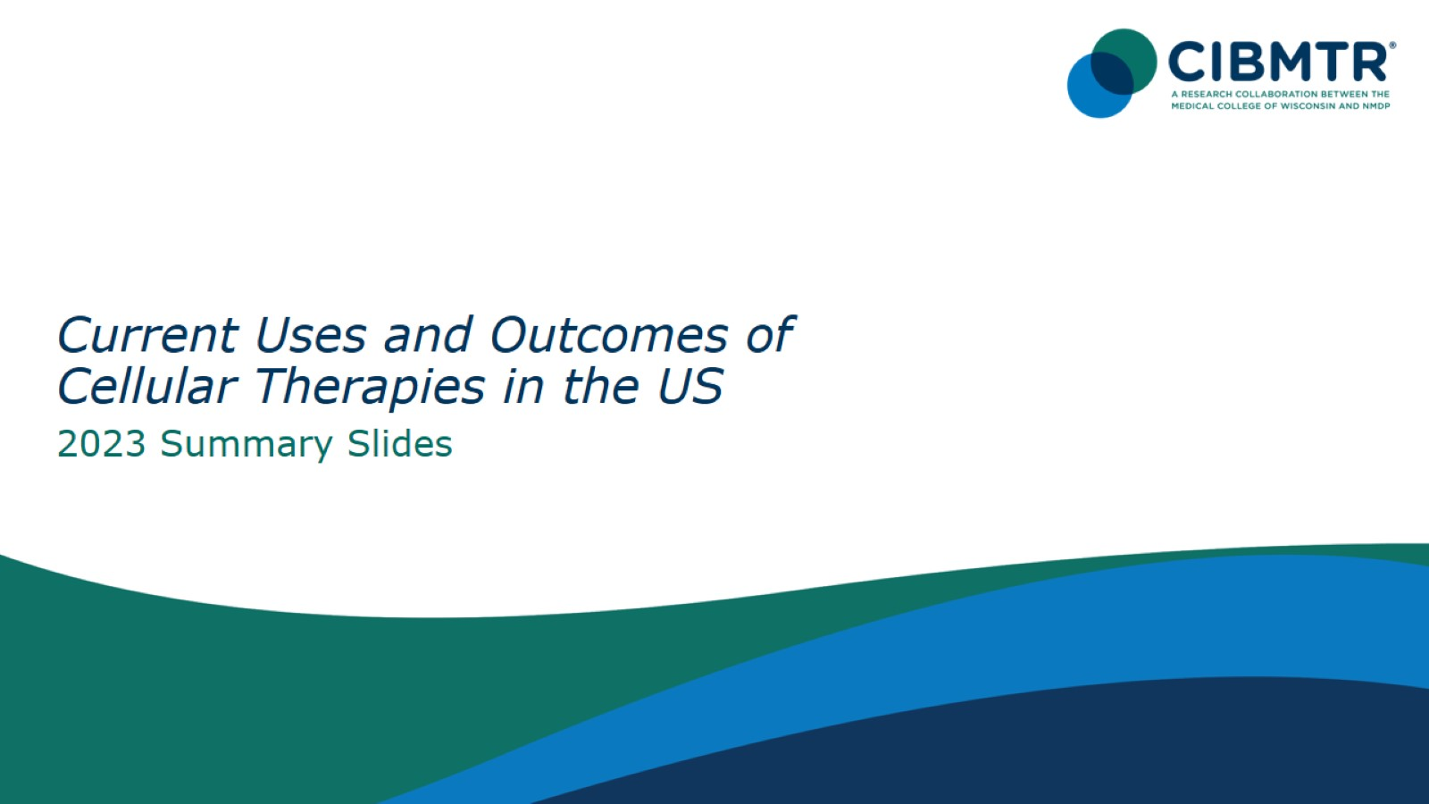
Notes:
INTRODUCTION: The Summary Slides are an annual report on data submitted to Center for International Blood and Marrow Transplant Research (CIBMTR) by centers in US and describe information related to practices and general survival outcomes after hematopoietic cell transplantation (HCT) and CAR T cell infusions. The current edition includes transplants performed prior to 2023.
Slides 3 to 40 exhibit data on frequency of transplants according to transplant and CAR–T infusion type, donor, patient age, graft source, graft-versus-host disease (GVHD) prophylaxis, disease, causes of death, conditioning regimen, and race and/or ethnicity. All frequencies represent first autologous and allogeneic transplants and CAR-T infusions registered with the CIBMTR during the period.
Slides 41 to 59 include overall survival outcomes according to age, donor type, disease, disease status, year of infusion, and race and ethnicity. Comparisons across survival curves are univariate and do not adjust for all potentially important factors; consequently, results should be interpreted cautiously.
Acute myeloid leukemia (AML), and acute lymphocytic leukemia (ALL) have disease status at HCT classified as CR1, CR2+ (2nd or subsequent complete remission) and relapse/ never in CR (includes primary induction failure).
Myelodysplastic syndromes (MDS) stage is divided into
Early disease (refractory anemia [RA] or refractory anemia with ringed sideroblasts [RARS], refractory cytopenia with unilineage dysplasia [RCUD], refractory cytopenia with multilineage dysplasia [RCMD], MDS with isolated del(5q))
Advanced disease (refractory anemia with excess blasts [RAEB] or chronic myelomonocytic leukemia [CMML]) disease).
Myeloproliferative neoplasms (MPN) include myelofibrosis, polycythemia vera, essential thrombocythemia, chronic myelomonocytic leukemia, chronic myeloproliferative disease-unclassifiable, chronic neutrophilic leukemia, chronic eosinophilic leukemia, and MPN not otherwise specified.
Chronic myeloid leukemia (CML) has disease stages classified as hematologic CR, chronic phase, accelerated phase or blast crisis.
Lymphomas are classified according to sensitivity to prior chemotherapy (chemosensitive or chemoresistant).
The classification of conditioning regimen intensity is based on the agents, doses and schedules used. Several classification systems are available, and for this report we used a composite classification. Cases defined as reduced-intensity by the transplant center were classified as such. Cases without such information and with available data on chemotherapy agents, radiation and doses, were classified according to the CIBMTR operational definition of conditioning regimen intensity:
Myeloablative conditioning regimen: regimens with total body irradiation doses of ≥ 500 cGY, single fractionated doses of ≥ 800 cGY, busulfan doses of > 9 mg/kg oral or Bu ≥ 7.2 mg/kg IV, or melphalan doses of >150 mg/m² given as single agents or in combination with other drugs.
Reduced-intensity conditioning/non-myeloablative regimen: regimens with lower doses of total body irradiation, fractionated radiation therapy, busulfan, melphalan, thiotepa and treosulfan than those used to define a myeloablative conditioning regimen (above).
References for conditioning intensity:
Bacigalupo A, Ballen K, Rizzo D, Giralt S, Lazarus H, Ho V, et al. Defining the intensity of conditioning regimens: working definitions. Biology of Blood and Marrow Transplantation: Journal of the American Society for Blood and Marrow Transplantation. 2009;15(12):1628–1633. doi: 10.1016/j.bbmt.2009.07.004.
Giralt S, Ballen K, Rizzo D, Bacigalupo A, Horowitz M, Pasquini M, et al. Reduced-intensity conditioning regimen workshop: defining the dose spectrum. Report of a workshop convened by the Center for International Blood and Marrow Transplant Research. Biology of Blood and Marrow Transplantation: Journal of the American Society for Blood and Marrow Transplantation. 2009;15(3):367–369. doi: 10.1016/j.bbmt.2008.12.497.
Renee D, Zhongyu F, Allbee-Johnson M, Bronwen S, Rachel C. Current use and outcome of hematopoietic stem cell transplantation: CIBMTR Summary Slides, 2023. Available at: https://cibmtr.org/CIBMTR/Resources/Summary-Slides-Reports

Slide 2
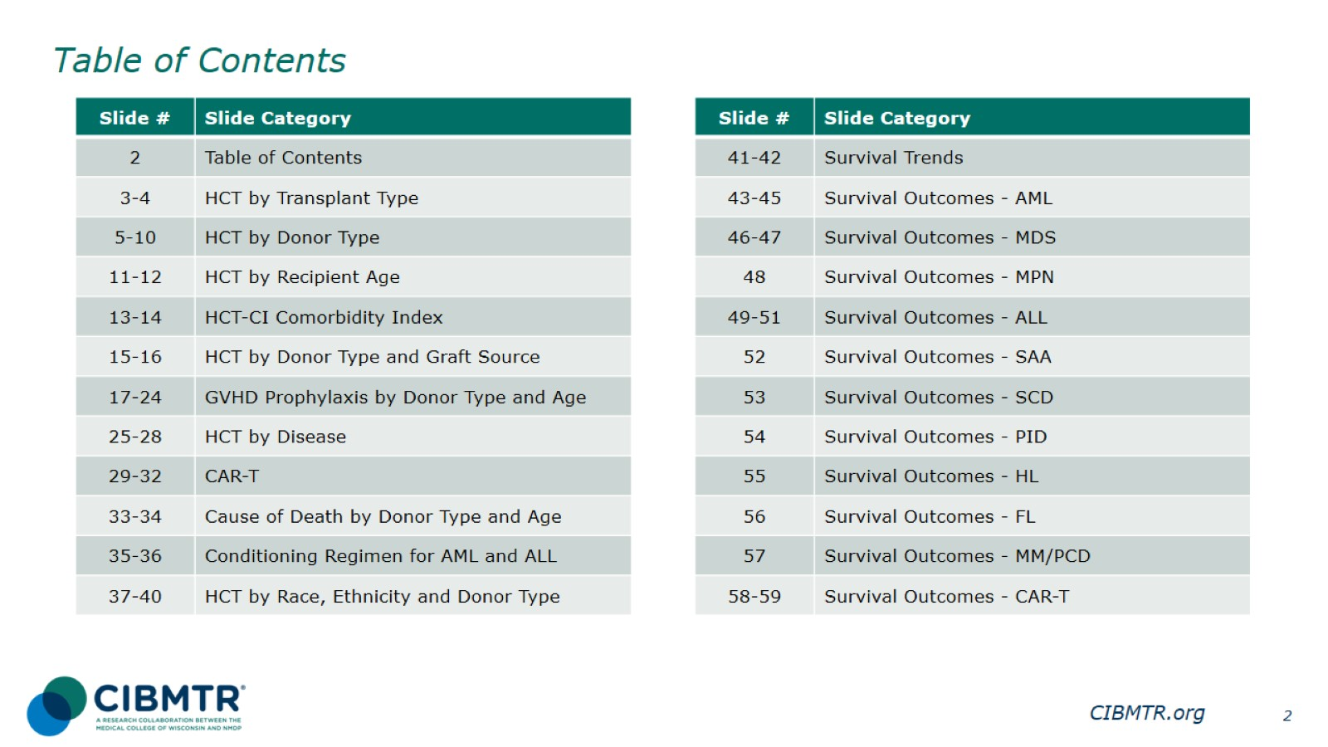
Table of Contents

Slide 3
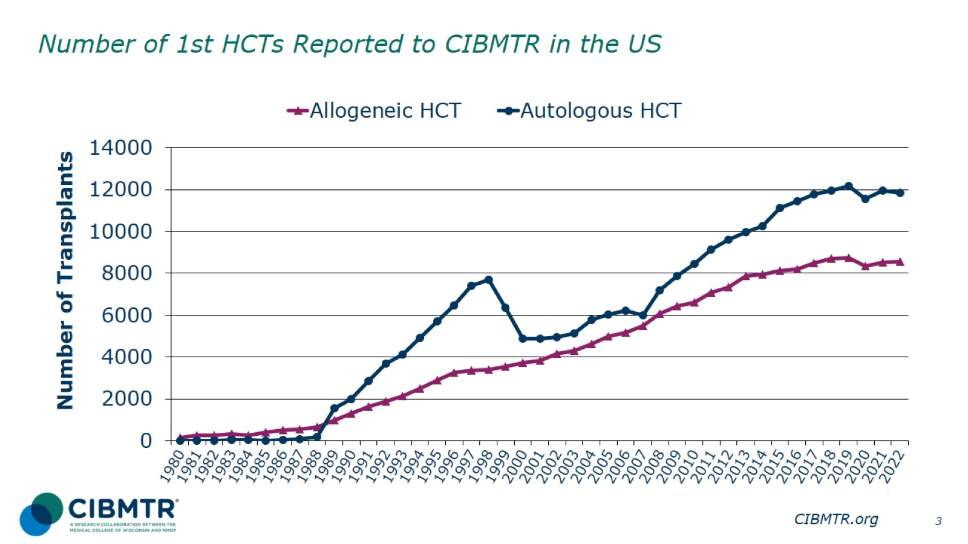
Number of 1st HCTs Reported to CIBMTR in the US
Notes:
Slide 3: The annual numbers of allogeneic and autologous transplant in the US were compiled according to the number of first transplants for recipients registered with the CIBMTR.

Slide 4
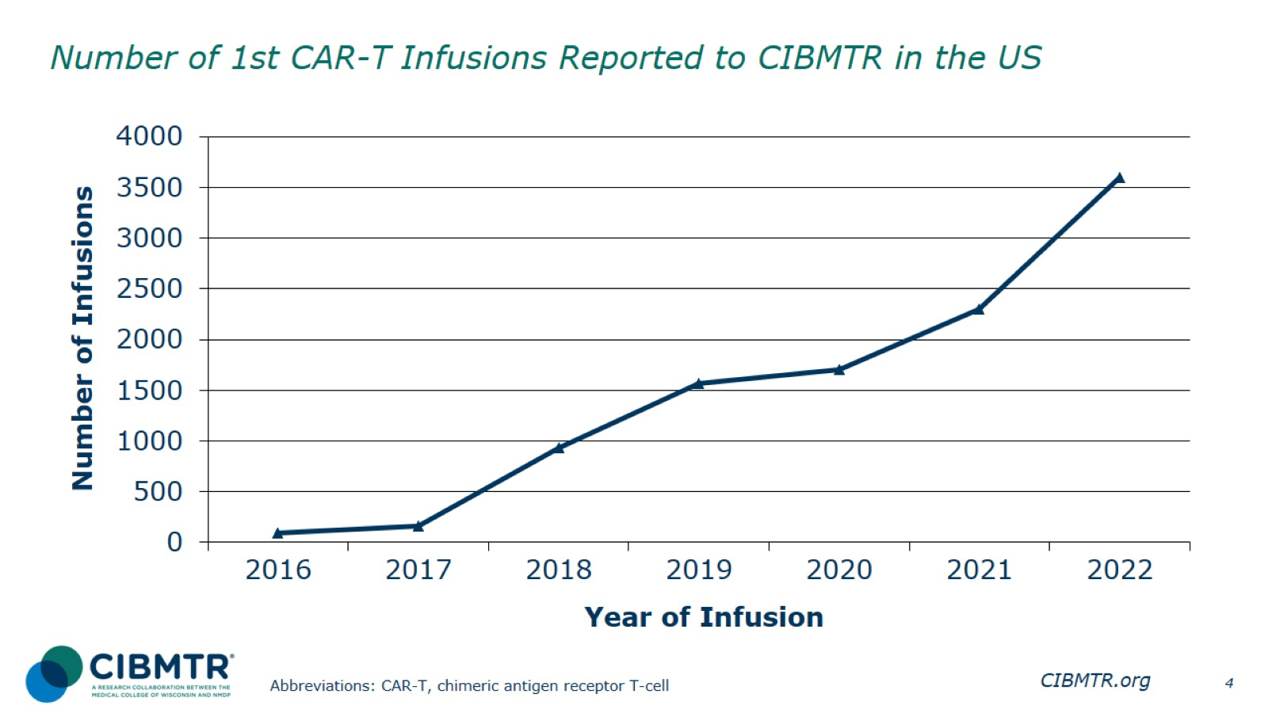
Number of 1st CAR-T Infusions Reported to CIBMTR in the US
Notes:
Slide 4: The number of first CAR-T infusions in the US reported to CIBMTR increased from 2016 to 2022.

Slide 5
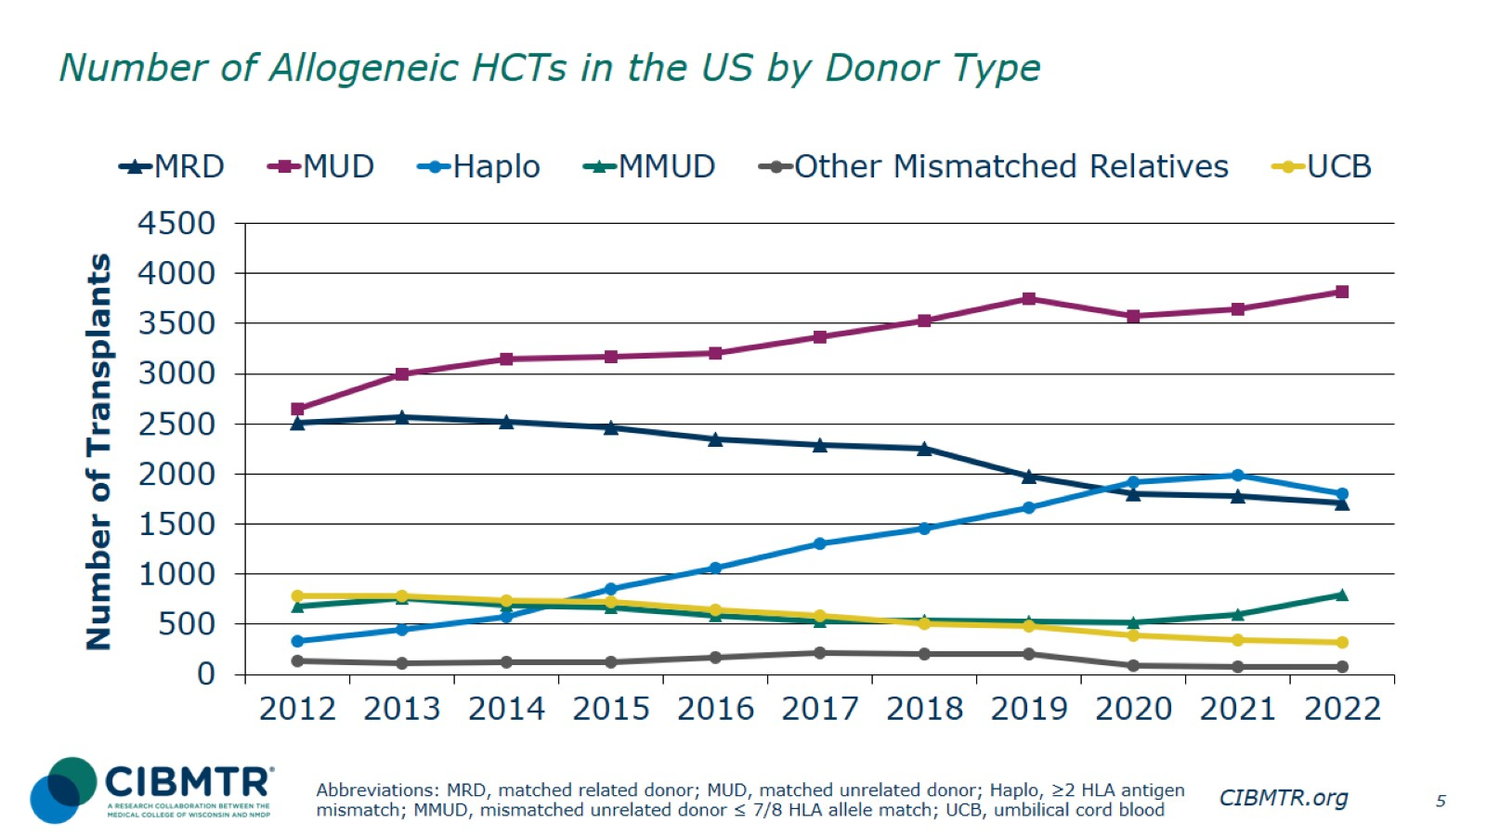
Number of Allogeneic HCTs in the US by Donor Type
Notes:
Slide 5: Upon further stratifying the number of allogeneic transplants in the US by donor type, matched unrelated donor (MUD) transplants represent the largest group, which continues to grow. The number of matched related donor (MRD) transplants has been decreasing for several years. The number of haplo procedures exceeded the number of matched related donor (MRD) transplants in 2020 but decreased since 2021. There is steady growth in mismatched unrelated donor (MMUD) transplants since 2020.

Slide 6
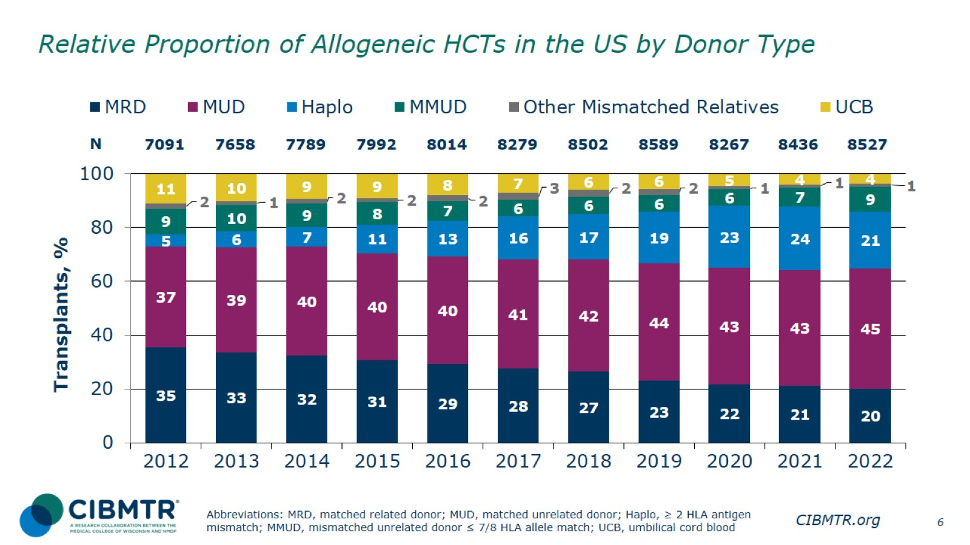
Relative Proportion of Allogeneic HCTs in the US by Donor Type
Notes:
Slide 6: This slide shows the relative proportion of allogeneic transplants performed by donor type annually, 2012-2022. The percentage of each is represented on the bar graph.

Slide 7
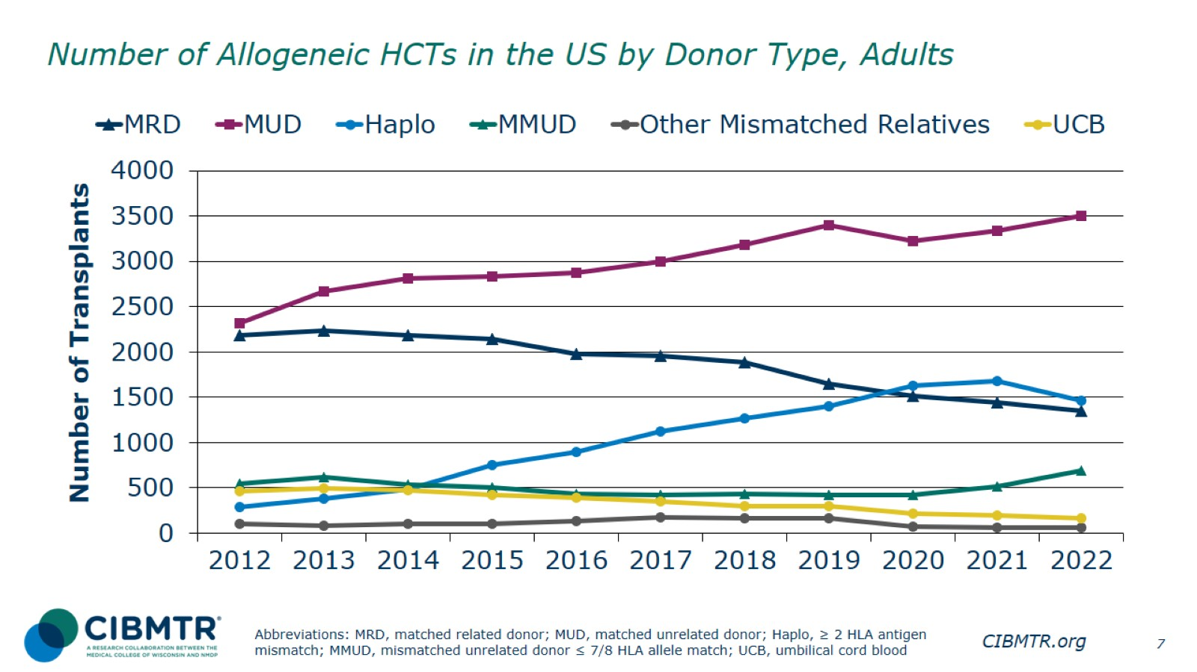
Number of Allogeneic HCTs in the US by Donor Type, Adults
Notes:
Slide 7: is a subset of the previous slide, looking specifically at adult patients. The trends of donor type used for adult patients reflect the general overall trends on the previous slide.

Slide 8
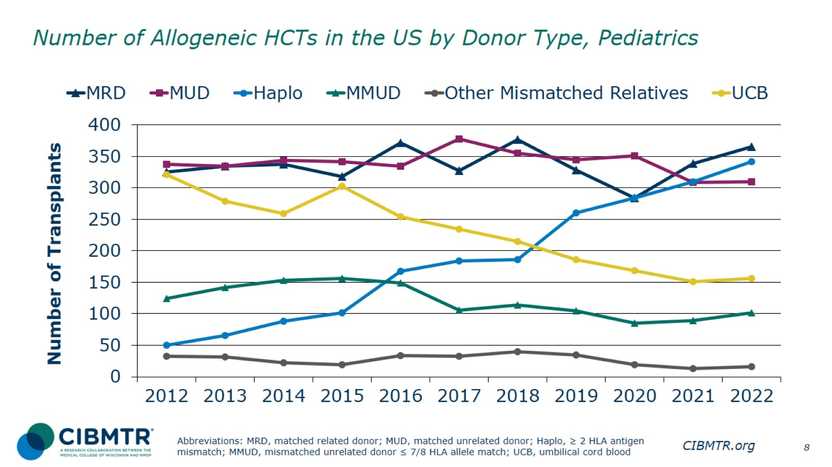
Number of Allogeneic HCTs in the US by Donor Type, Pediatrics
Notes:
Slide 8: In pediatric transplants (recipients younger than 18), matched related donor (MRD) transplants represent the largest donor group, followed by matched unrelated donor (MUD) and haploidentical donors. Haplo transplants show steady increases over the last 10 years, while the number of cord blood donor (UCB) transplants shows steady decreases. The use of MMUD has varied over time, with increases since 2020.

Slide 9
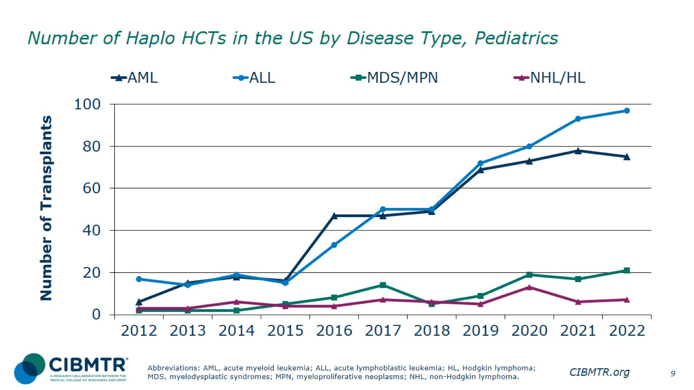
Number of Haplo HCTs in the US by Disease Type, Pediatrics
Notes:
Slide 9: Haplo donor use is increasing in pediatric recipients across all indications, with the exception of a recent decrease for AML.

Slide 10
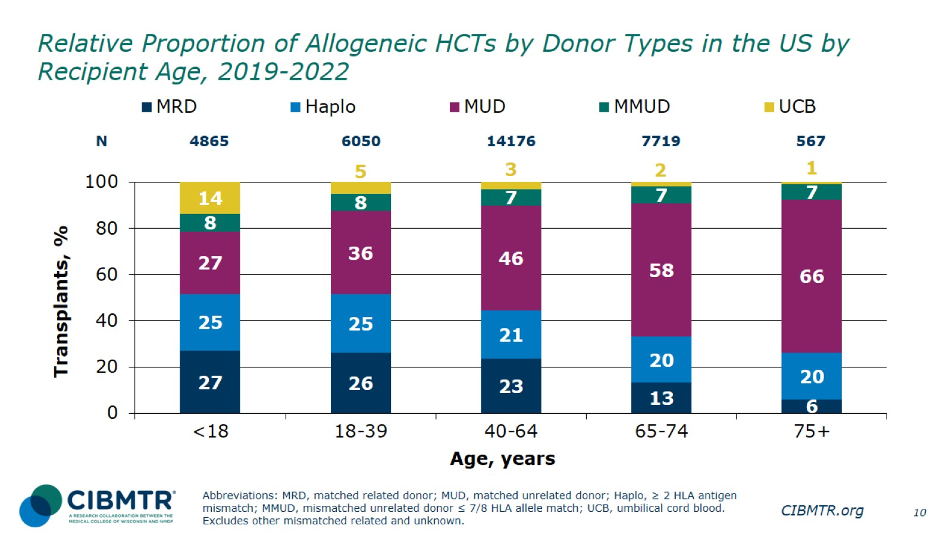
Relative Proportion of Allogeneic HCTs by Donor Types in the US by Recipient Age, 2019-2022
Notes:
Slide 10: This slide shows the relative proportion of allogeneic transplants by donor type performed for different recipient age groupings, 2019-2022. The percentage of each is represented on the bar graph.

Slide 11
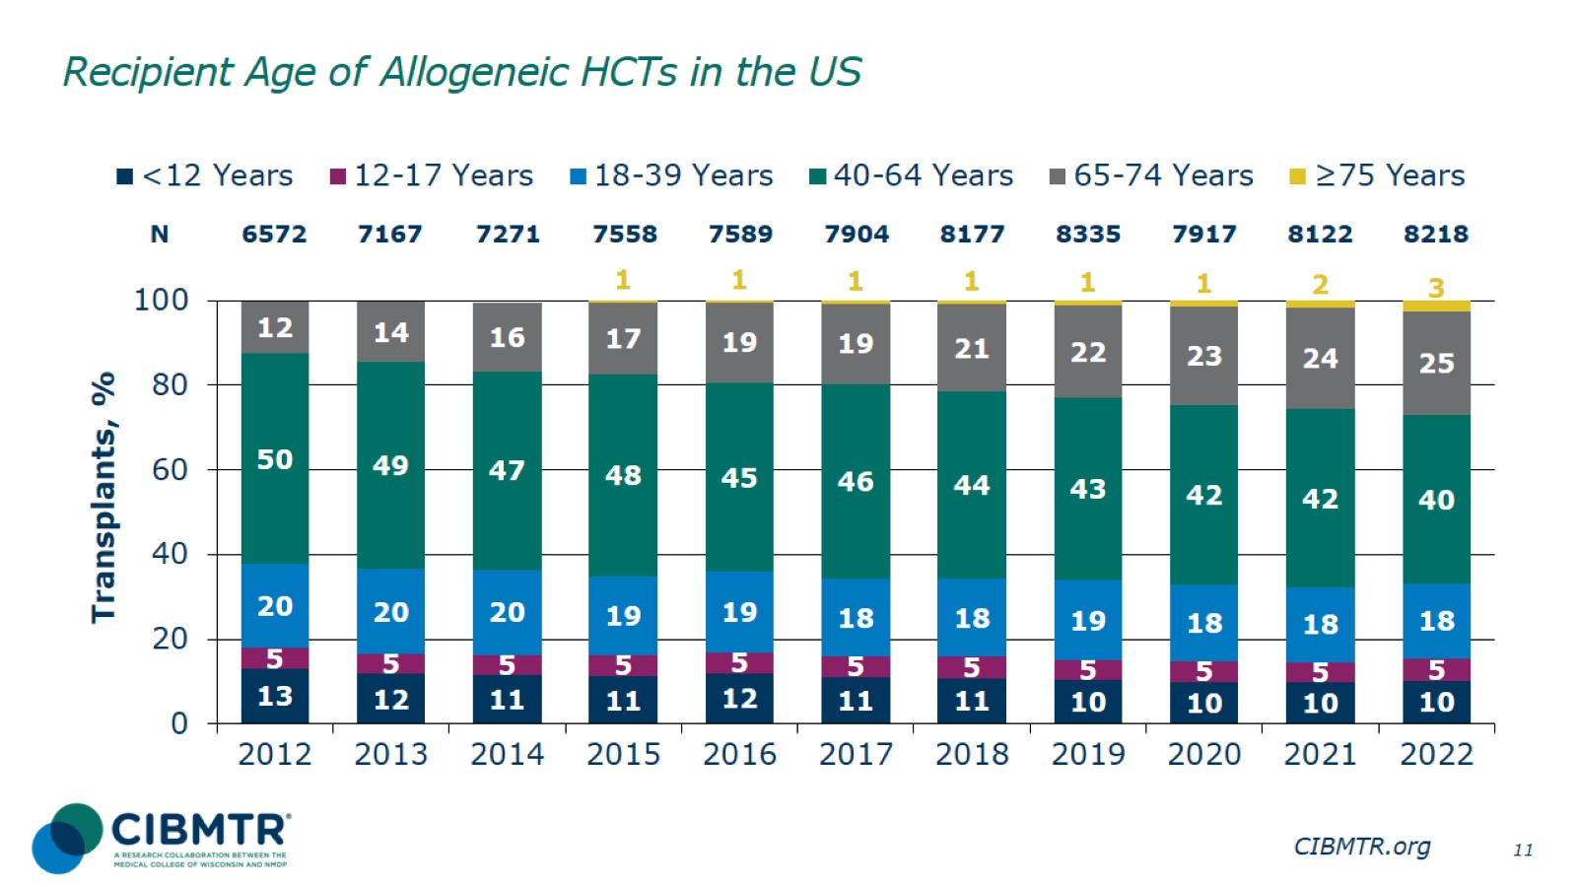
Recipient Age of Allogeneic HCTs in the US
Notes:
Slide 11: This slide shows the relative proportion of recipient age groups for allogeneic HCT recipients, 2012-2022. The percentage of each is represented on the bar graph. The percentage of recipients younger than 40 remains relatively constant. The percentage of patients aged 65 and older is increasing significantly over time.

Slide 12
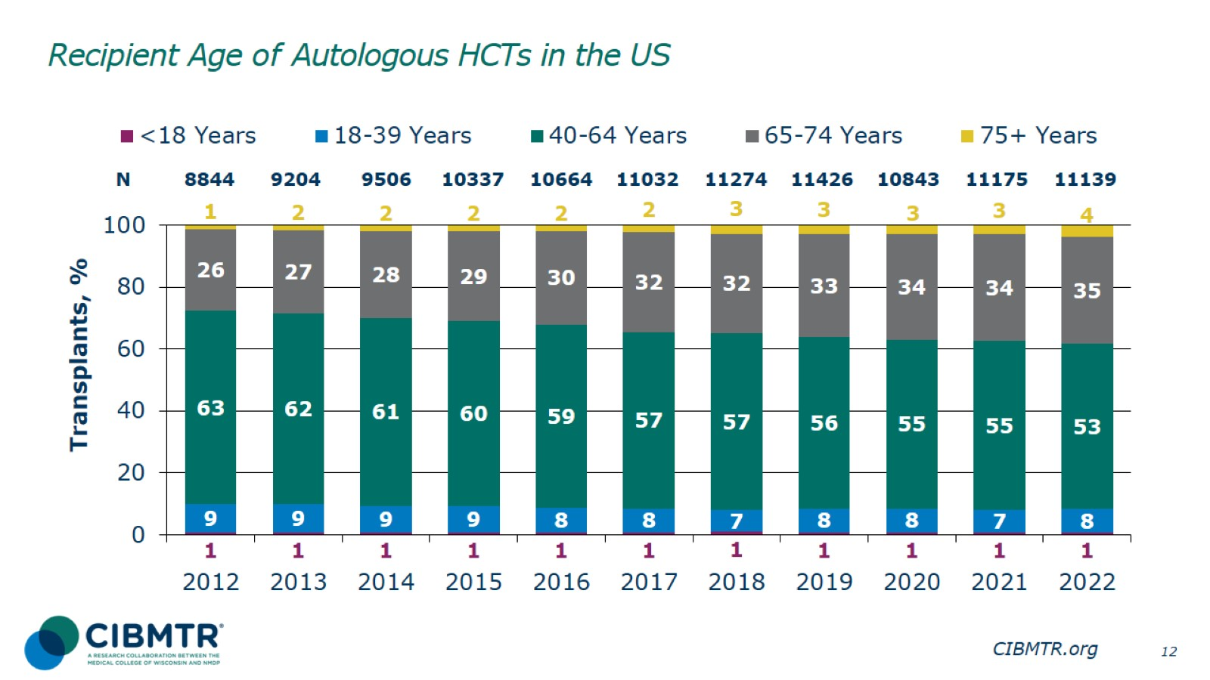
Recipient Age of Autologous HCTs in the US
Notes:
Slide 12: This slide shows the relative proportion of recipient age groups for autologous HCT recipients, 2012-2022. The percentage of each is represented on the bar graph. The percentage of patients aged 65 and older has increased significantly since 2012.

Slide 13
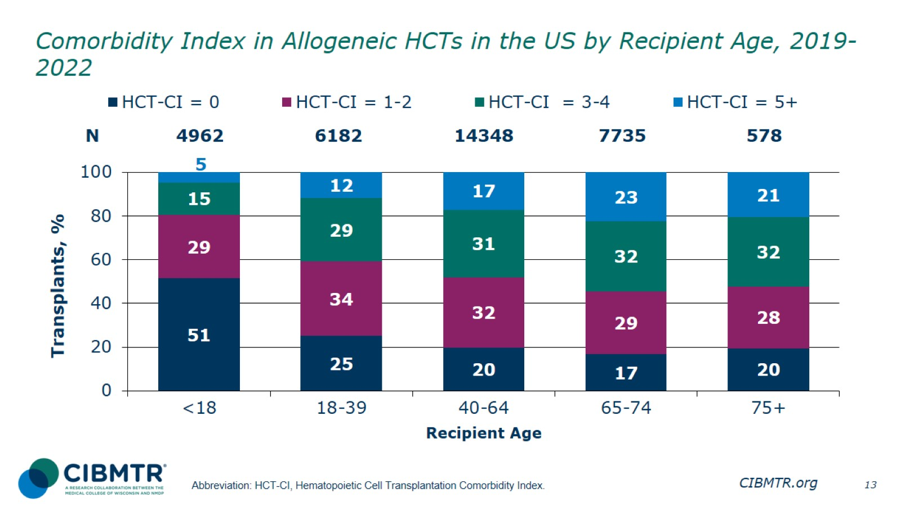
Comorbidity Index in Allogeneic HCTs in the US by Recipient Age, 2019-2022
Notes:
Slide 13: This slide shows the relative proportion of allogeneic transplants performed by Hematopoietic Cell Transplantation Comorbidity Index group (HCT-CI) in the different age groups between 2019-2022.

Slide 14
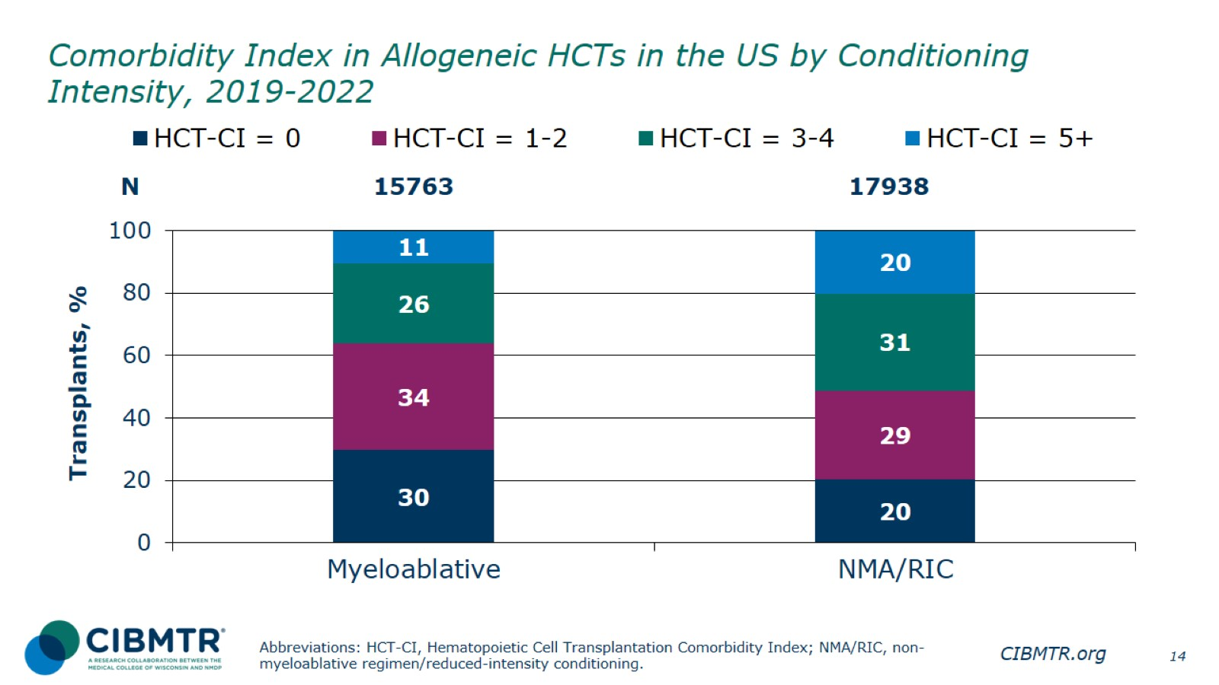
Comorbidity Index in Allogeneic HCTs in the US by Conditioning Intensity, 2019-2022
Notes:
Slide 14: The percentage of allogeneic recipients by Hematopoietic Cell Transplantation Comorbidity Index (HCT-CI) index group receiving myeloablative or non-myeloablative/reduced-intensity conditioning, 2019-2022. There were a higher percentage of HCT-CI = 3-4 and HCT-CI = 5+ in the non-myeloablative/reduced-intensity conditioning group.

Slide 15
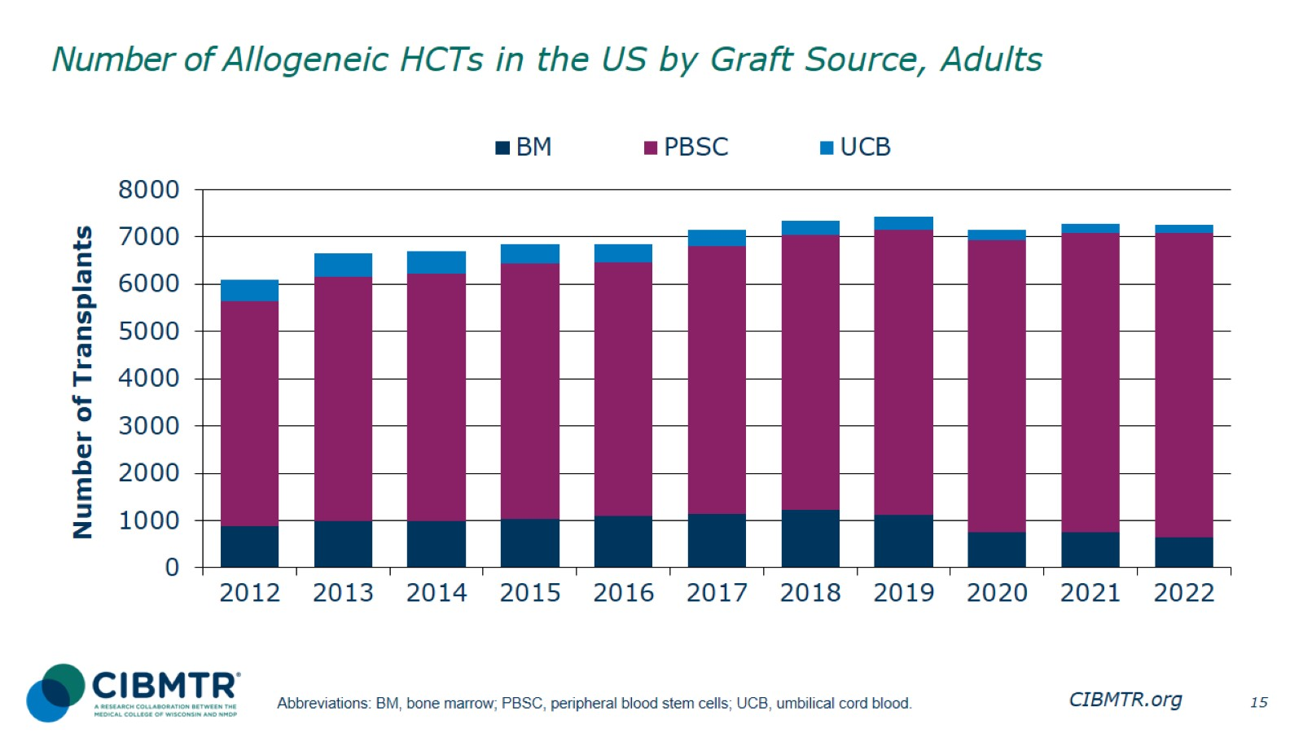
Number of Allogeneic HCTs in the US by Graft Source, Adults
Notes:
Slide 15: This slide shows the number of allogeneic procedures by graft sources in adult patients since 2012.

Slide 16
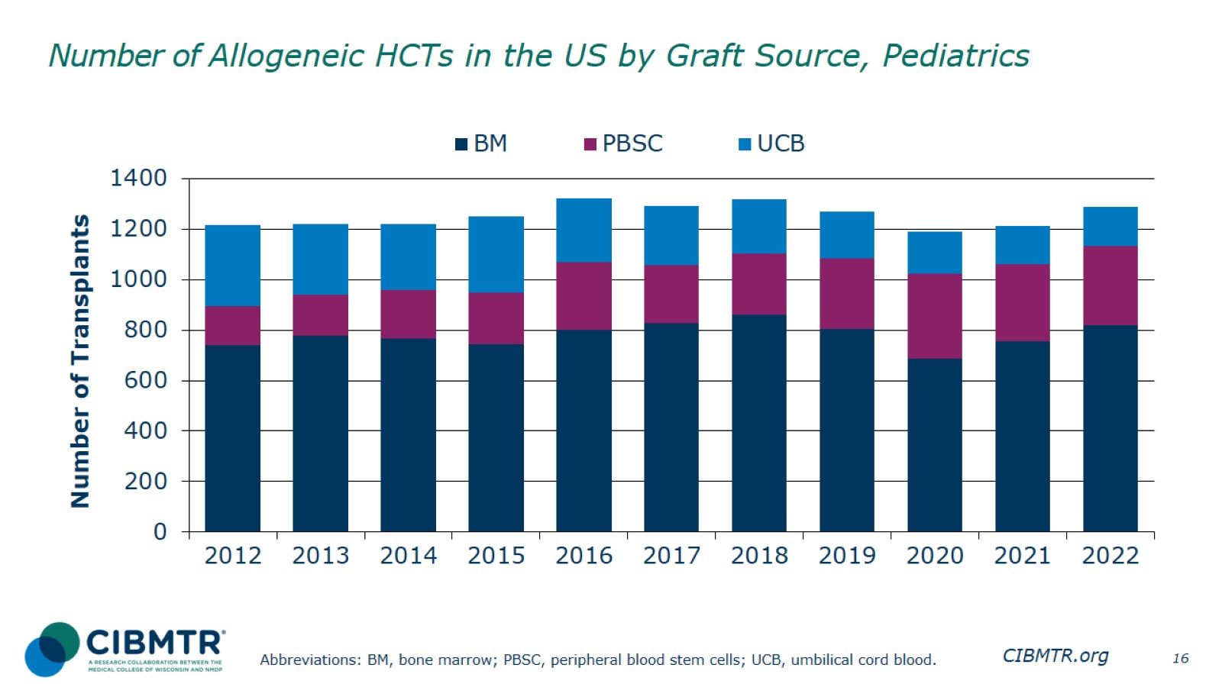
Number of Allogeneic HCTs in the US by Graft Source, Pediatrics
Notes:
Slide 16: This slide shows the number of allogeneic procedures by graft sources among pediatric recipients, 2012-2022. Bone marrow represents the largest graft source consistently each year.

Slide 17
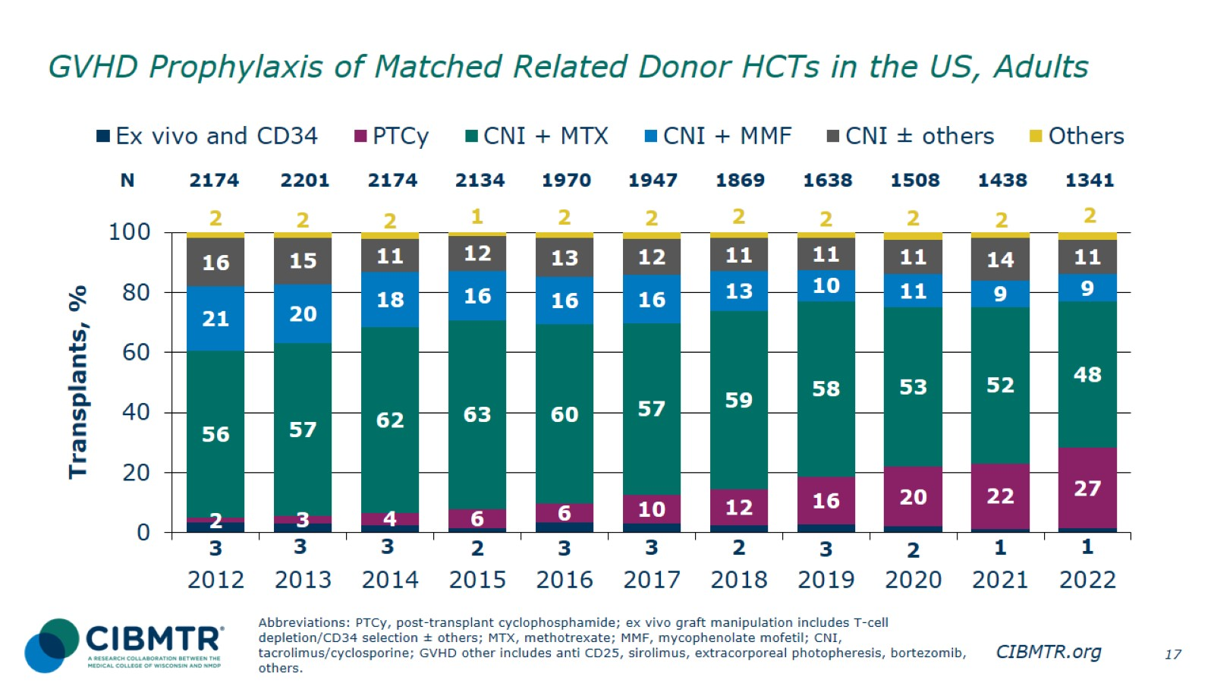
GVHD Prophylaxis of Matched Related Donor HCTs in the US, Adults
Notes:
Slide 17: While calcineurin inhibitor (CNI) based graft-versus-host disease (GVHD) prophylaxis remains the most commonly used in adult matched related donor (MRD) recipients, the use of post-transplant cyclophosphamide (PTCy) continues to increase, especially in recent years.

Slide 18
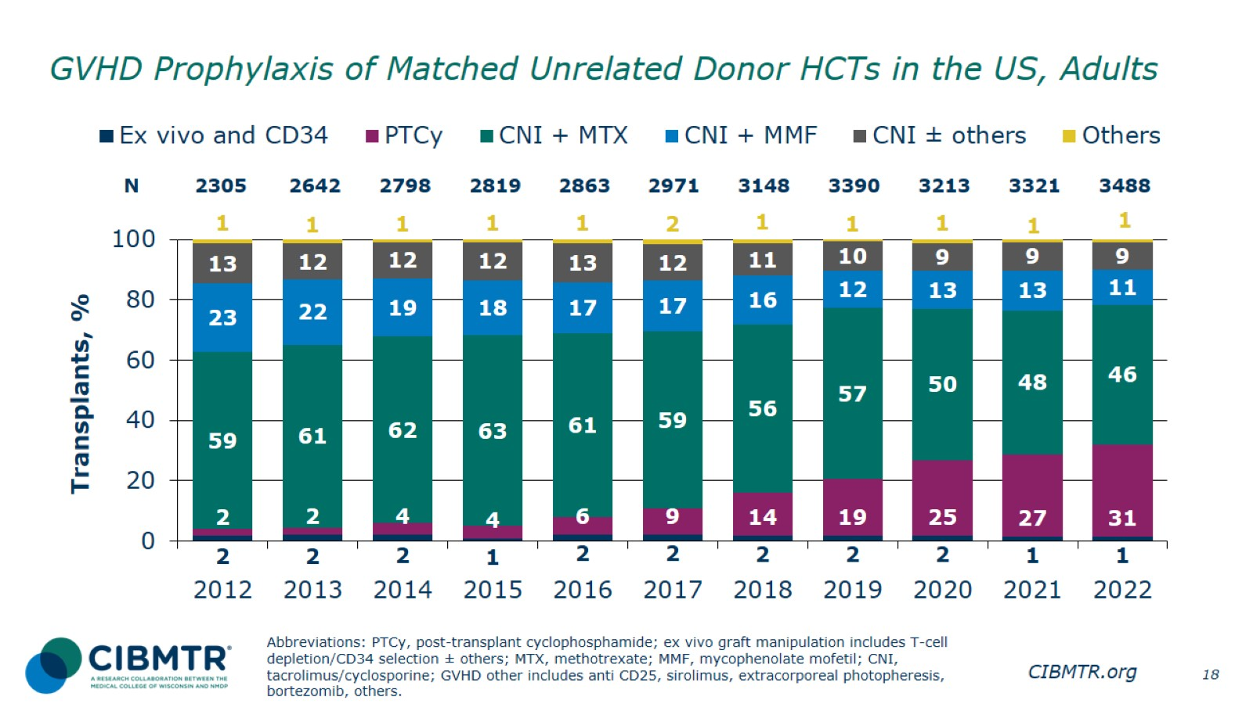
GVHD Prophylaxis of Matched Unrelated Donor HCTs in the US, Adults
Notes:
Slide 18: While CNI-based GVHD prophylaxis remains the most commonly used in adult MUD recipients, the use of PTCy continues to increase, especially in recent years.

Slide 19
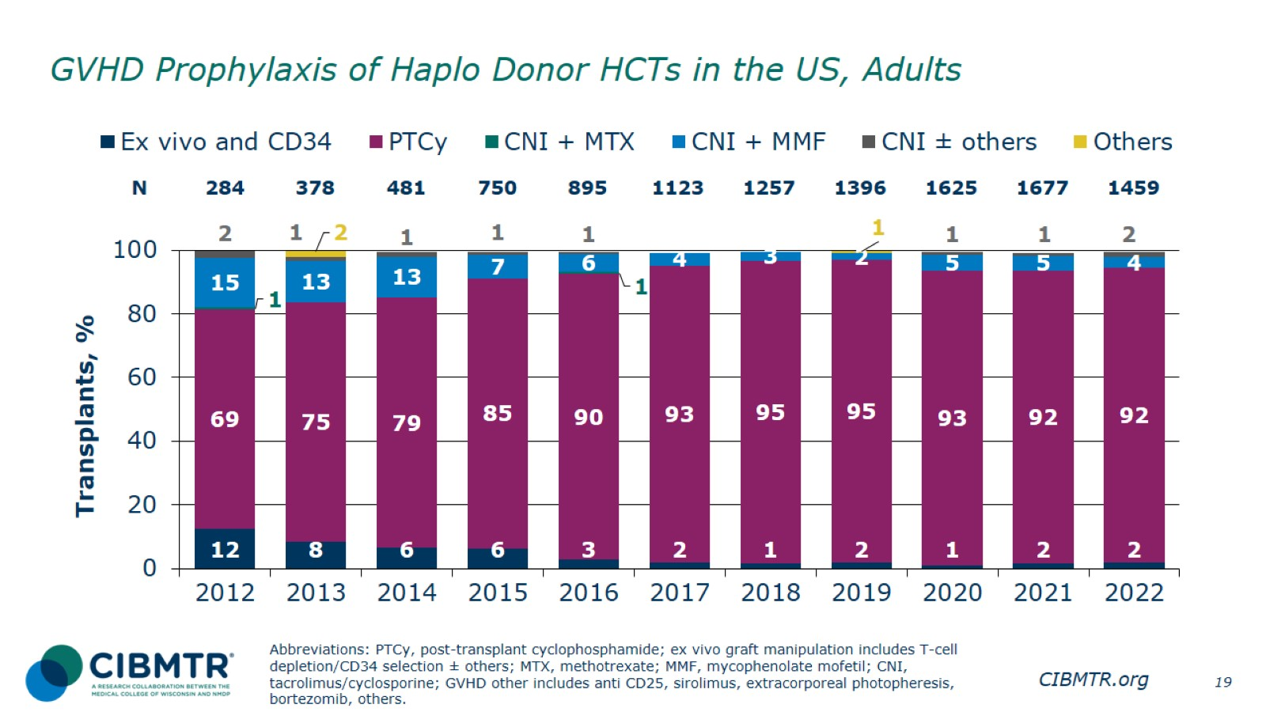
GVHD Prophylaxis of Haplo Donor HCTs in the US, Adults
Notes:
Slide 19: GVHD prophylaxis for adults receiving haplo donor HCT is almost exclusively with PTCy.

Slide 20
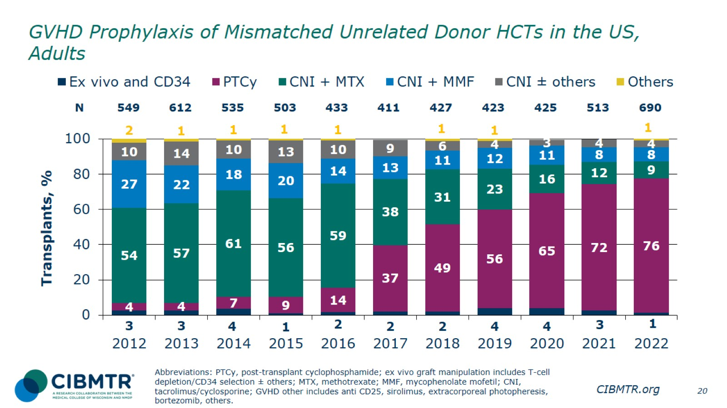
GVHD Prophylaxis of Mismatched Unrelated Donor HCTs in the US, Adults
Notes:
Slide 20: Since 2019, GVHD prophylaxis for adults receiving MMUD HCT with PTCy is > 50%, and this continues to increase.

Slide 21
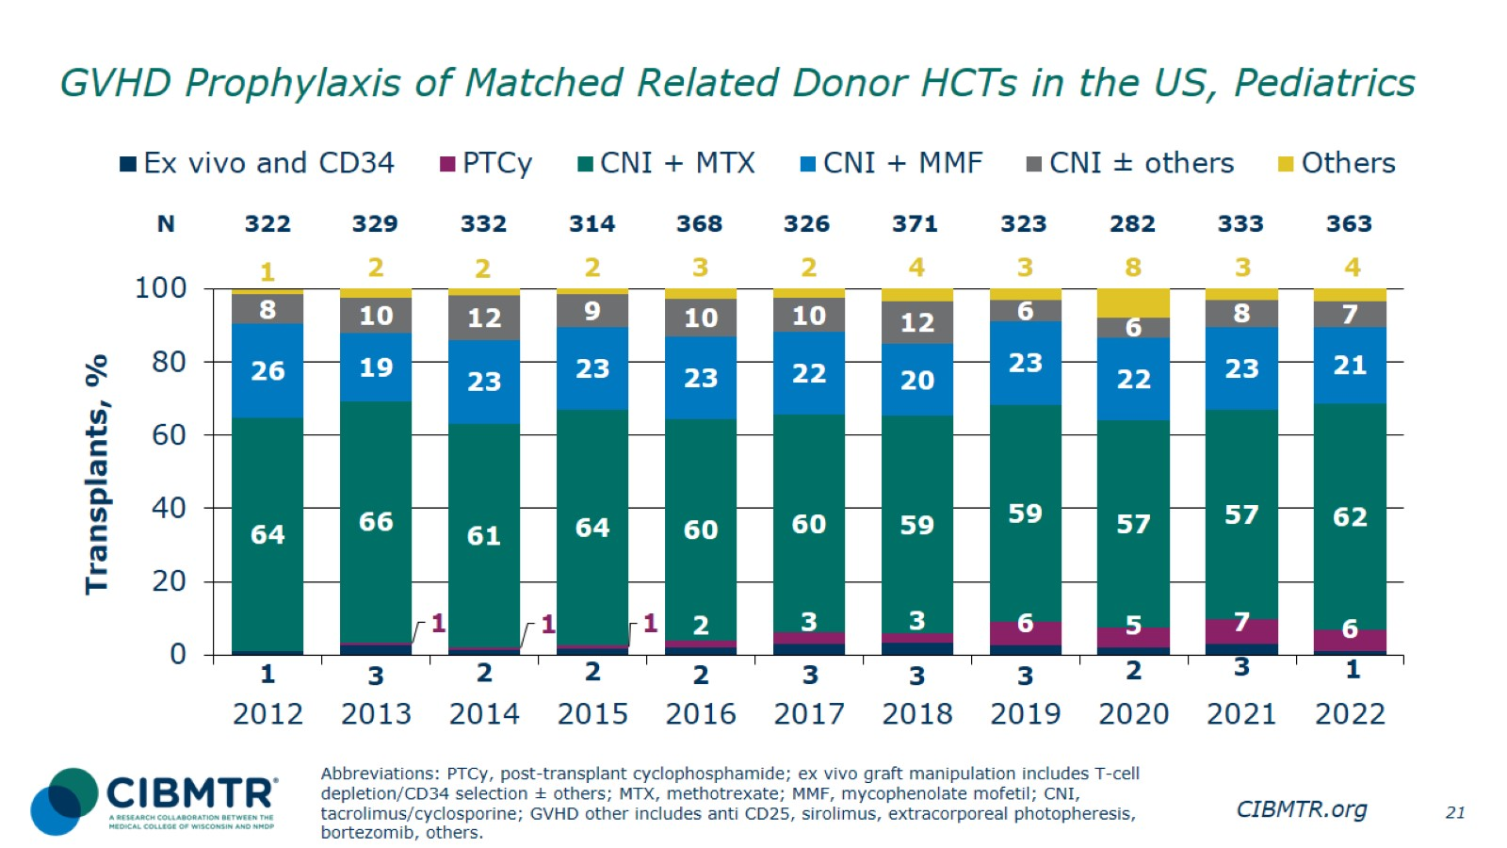
GVHD Prophylaxis of Matched Related Donor HCTs in the US, Pediatrics
Notes:
Slide 21: CNI-based GVHD prophylaxis remains the most commonly used in pediatric MRD recipients.

Slide 22
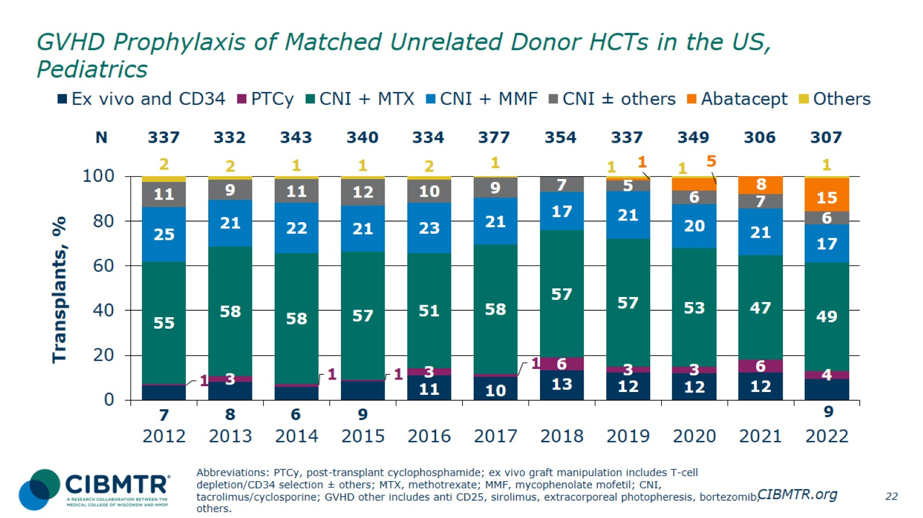
GVHD Prophylaxis of Matched Unrelated Donor HCTs in the US, Pediatrics
Notes:
Slide 22: CNI-based GVHD prophylaxis remains the most commonly used in pediatric MUD recipients, although a steady proportion receive graft manipulation strategies. There is a notable increase in the use of abatacept since 2020.

Slide 23
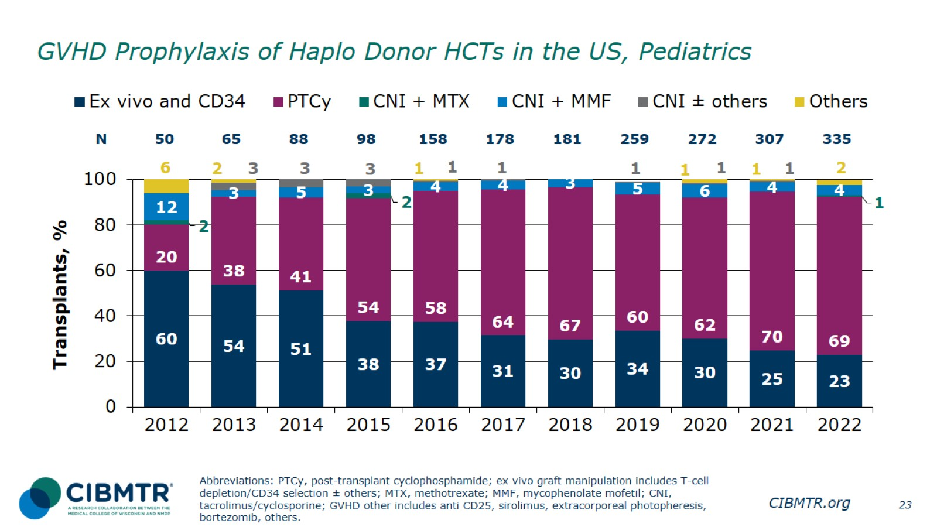
GVHD Prophylaxis of Haplo Donor HCTs in the US, Pediatrics
Notes:
Slide 23: GVHD prophylaxis for pediatric patients receiving haplo donor HCT is predominantly with PTCy, though graft manipulation is also used commonly.

Slide 24
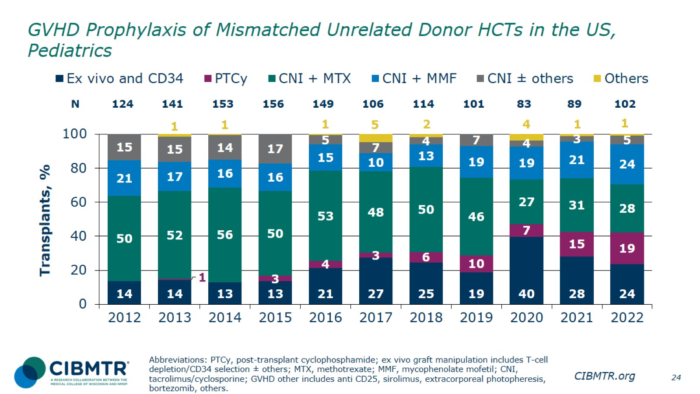
GVHD Prophylaxis of Mismatched Unrelated Donor HCTs in the US, Pediatrics
Notes:
Slide 24: There is broad variation in the GVHD prophylaxis used for pediatric patients, especially in recent years.

Slide 25
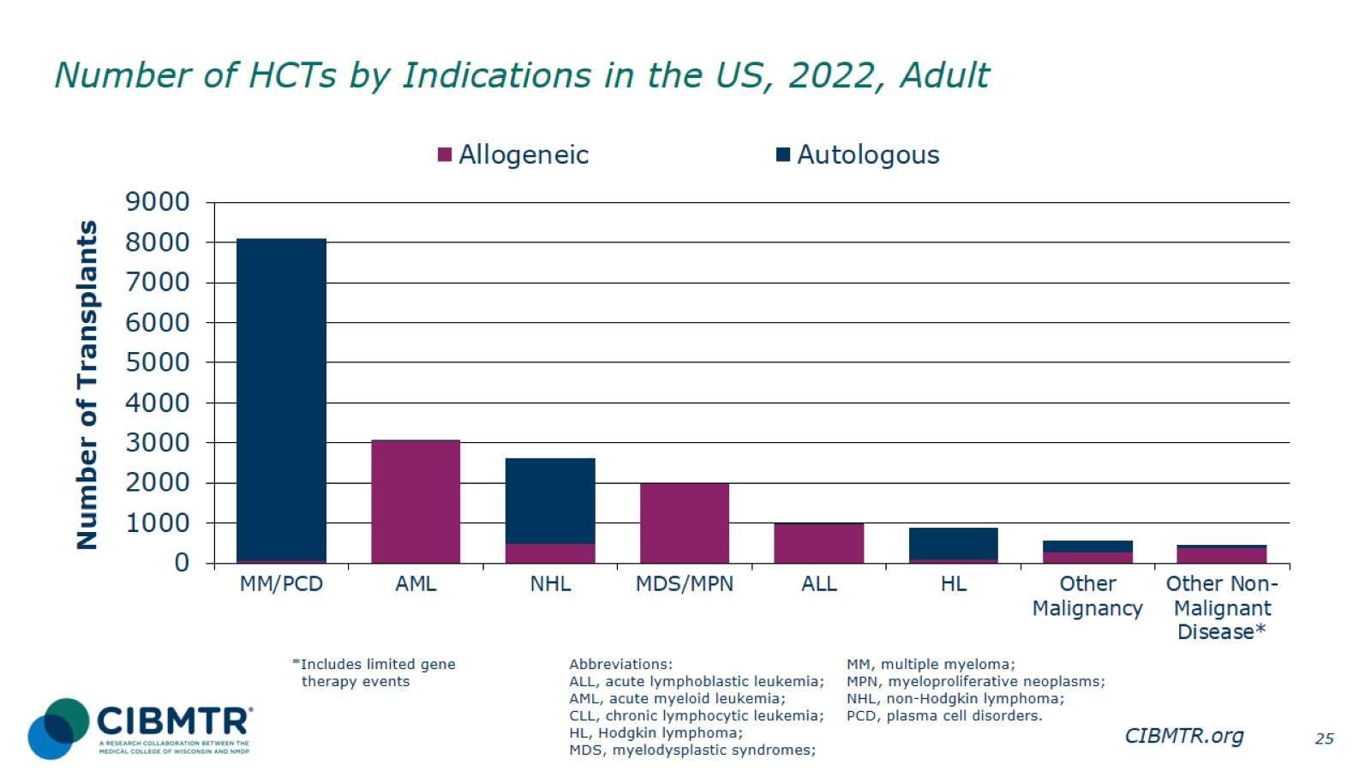
Number of HCTs by Indications in the US, 2022, Adult
Notes:
Slide 25: The most common indications are AML for allogeneic HCT and MM/PCD for autologous HCT in the US in 2022 for adult patients.

Slide 26
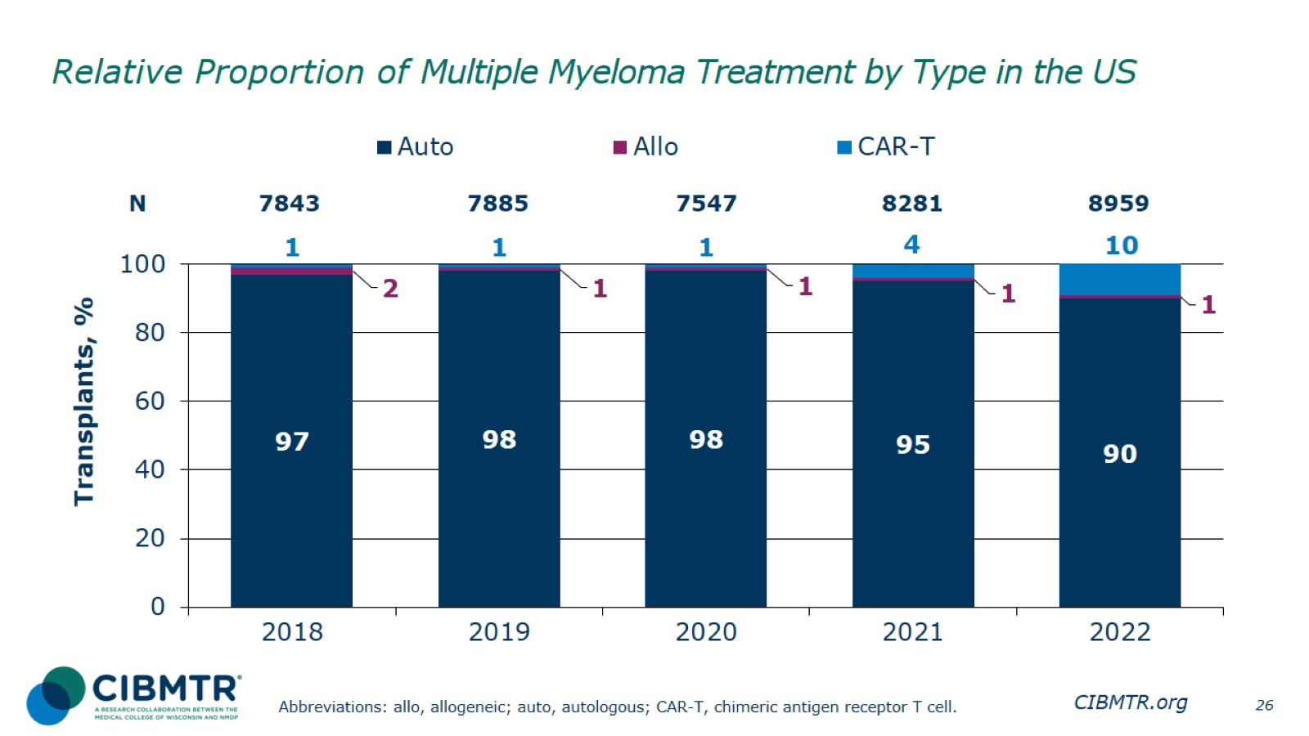
Relative Proportion of Multiple Myeloma Treatment by Type in the US
Notes:
Slide 26: The most common treatment type for multiple myeloma is autologous HCT, accounting for majority of the cases with an increase in the use of CAR-T therapies seen in 2022.

Slide 27
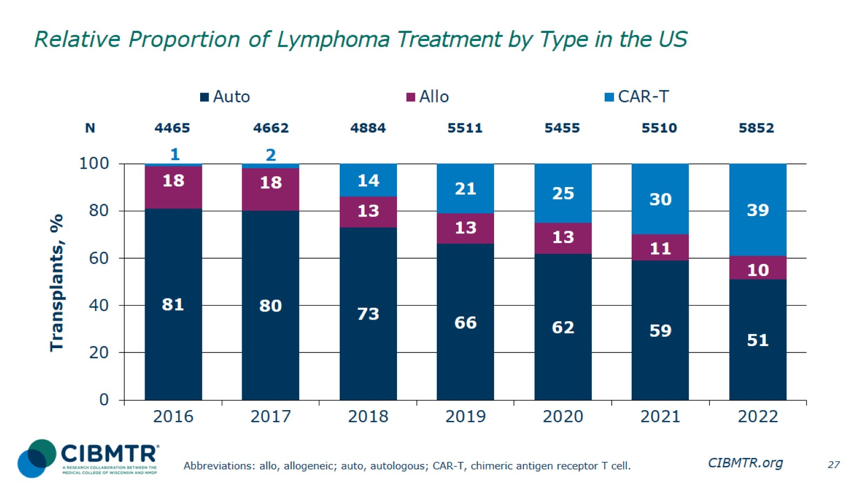
Relative Proportion of Lymphoma Treatment by Type in the US
Notes:
Slide 27: The most common treatment type for lymphoma remains autologous HCT although this has significantly decreased since 2018, following the increase in the number of CAR-T therapies. The percentage of allogeneic HCT remains approximately stable.

Slide 28
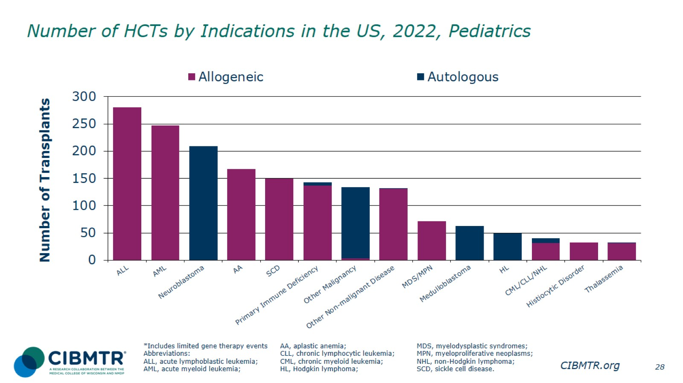
Number of HCTs by Indications in the US, 2022, Pediatrics
Notes:
Slide 28: The most common indications are ALL for allogeneic HCT and neuroblastoma for autologous HCT in the US in 2022 for pediatric patients.

Slide 29
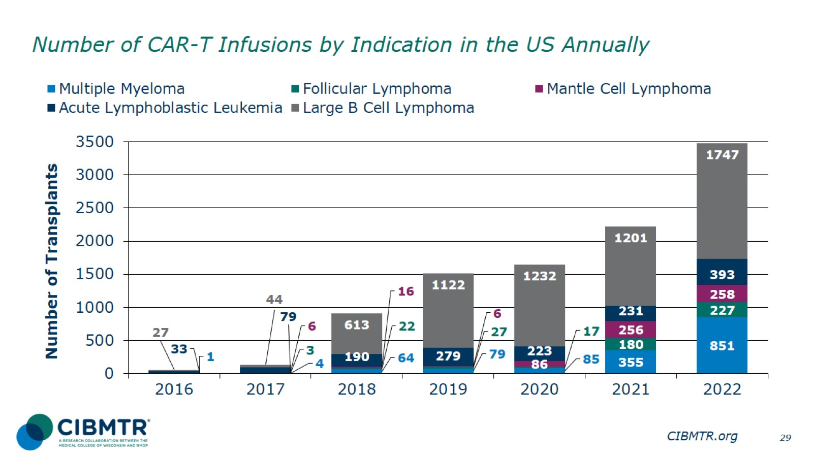
Number of CAR-T Infusions by Indication in the US Annually
Notes:
Slide 29: Diffuse large B-cell lymphoma (DLBCL) is the most common indication among patients receiving CAR-T, increasing in number from 2016 to 2022.

Slide 30
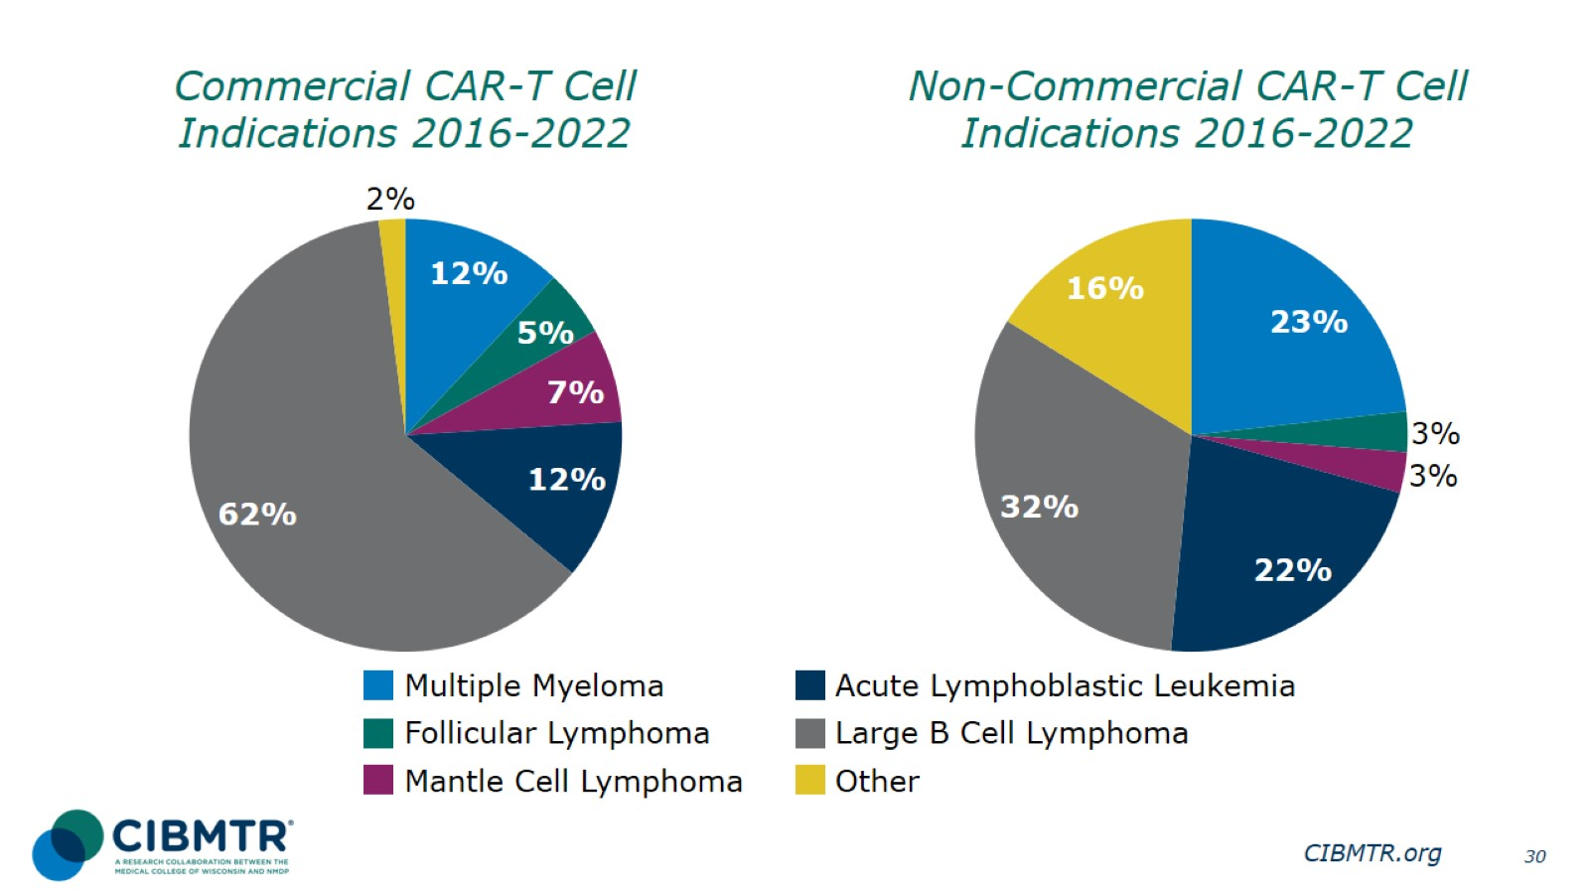
Notes:
Slide 30: DLBCL was the most common commercial CAR-T cell indication during 2016-2022, accounting for 62% of all cases. DLBCL was also the most common non-commercial CAR-T cell indication during 2016-2022, accounting for 32% of all cases for the same time interval.

Slide 31
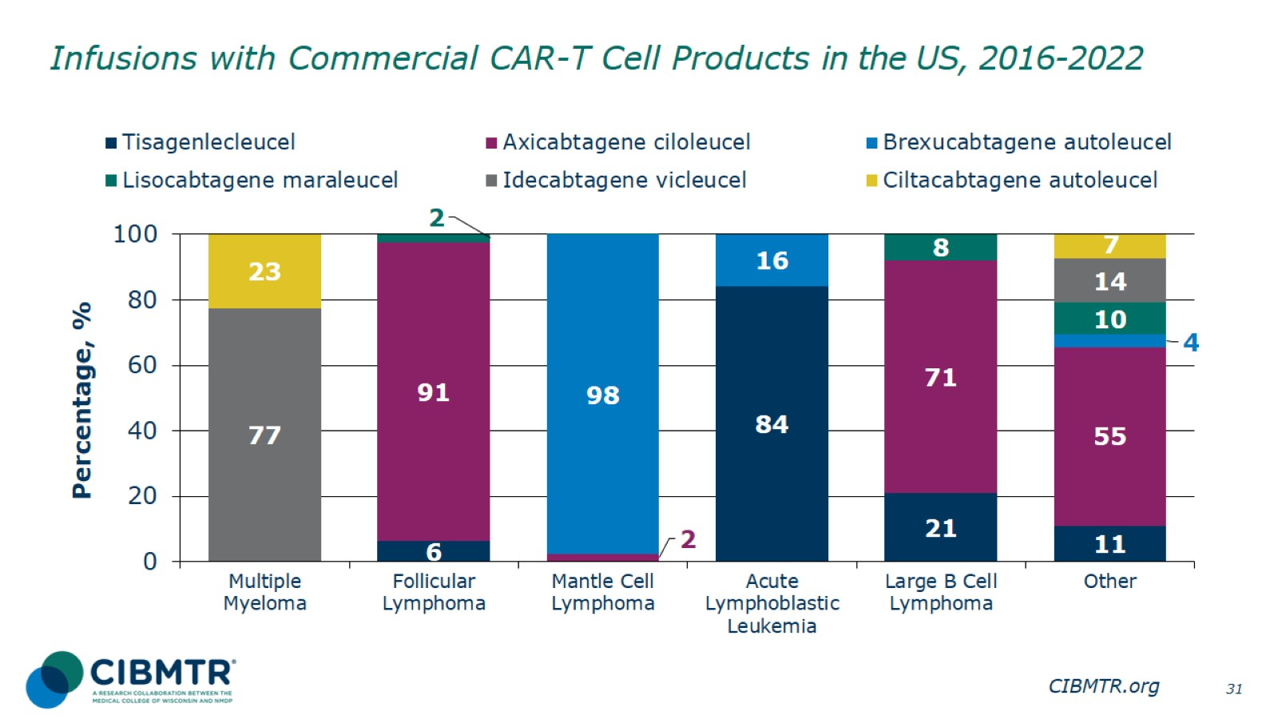
Infusions with Commercial CAR-T Cell Products in the US, 2016-2022
Notes:
Slide 31: Number of commercial CAR-T cell product by disease, 2016-2022. Axicabtagene ciloleucel accounts for 91% of follicular lymphoma cases, and brexucabtagene autoleucel accounts for 98% of mantle cell lymphoma cases

Slide 32
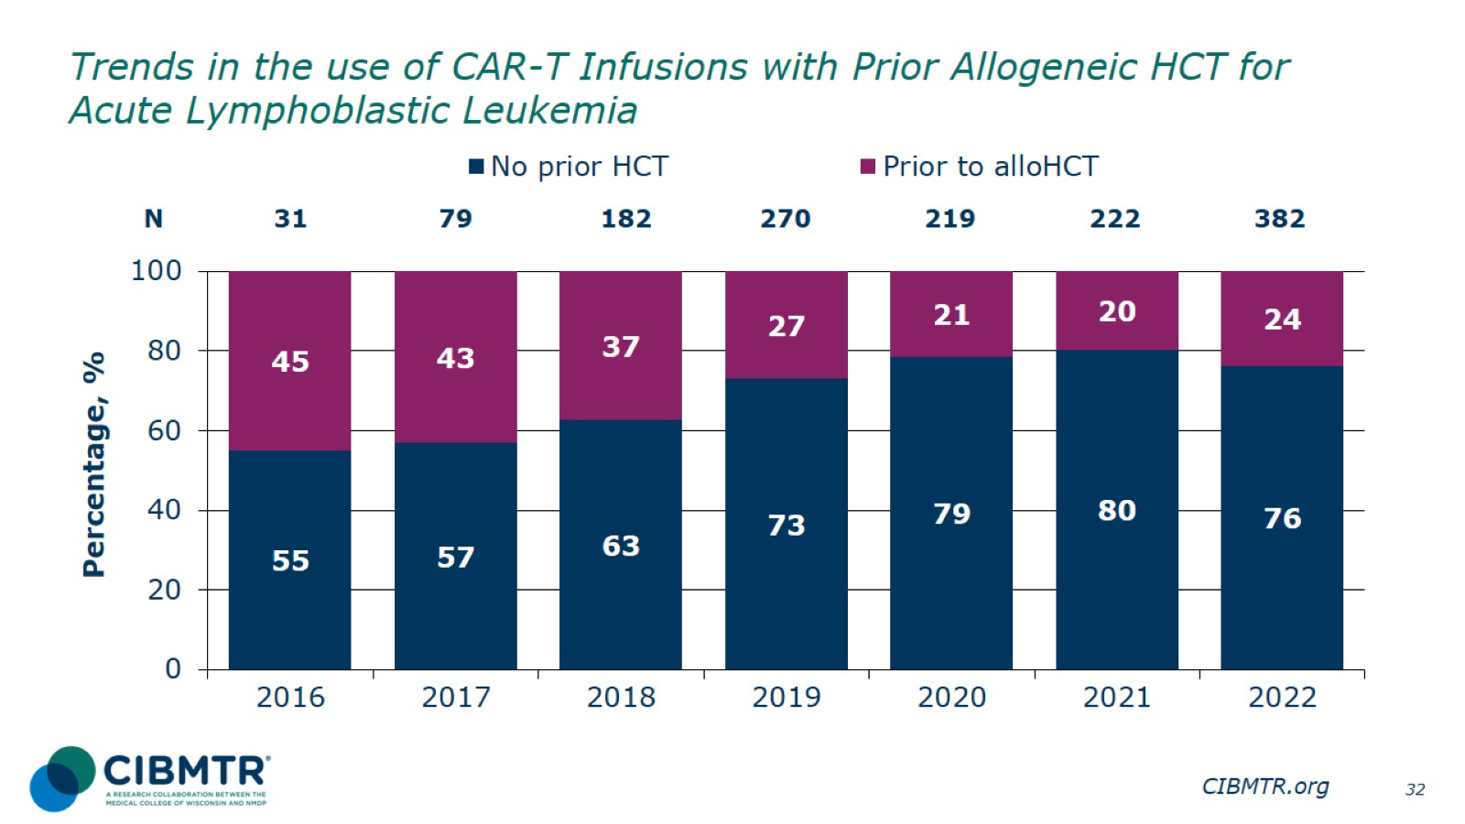
Trends in the use of CAR-T Infusions with Prior Allogeneic HCT for Acute Lymphoblastic Leukemia
Notes:
Slide 32: The percentage of patients receiving CAR-T with no prior HCT increased from 2016 to 2019 but remains approximately stable thereafter.

Slide 33
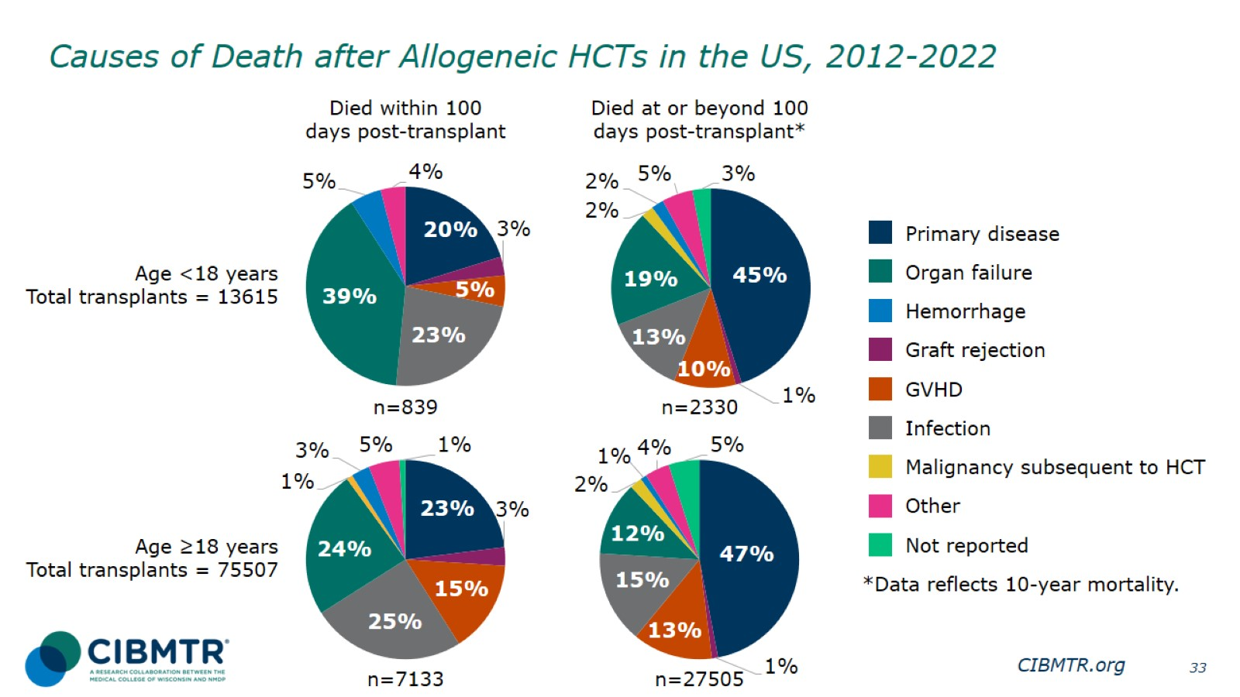
Causes of Death after Allogeneic HCTs in the US, 2012-2022
Notes:
Slide 33: Approximately half of deaths for recipients of allogeneic transplants are due to disease relapse after 100 days, in both adults and pediatric patients. Within the first 100 days, disease relapse, organ failure, and infection are the three most common causes of death.

Slide 34
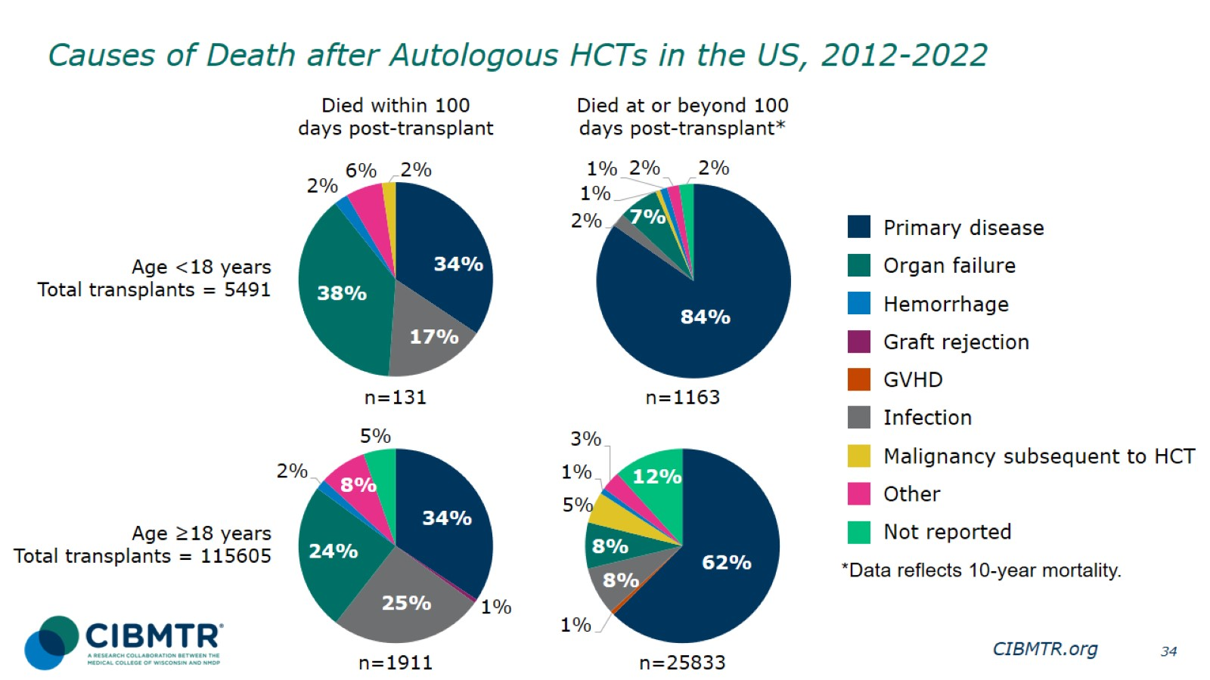
Causes of Death after Autologous HCTs in the US, 2012-2022
Notes:
Slide 34: The primary cause of death for recipients of autologous transplants is disease relapse, though organ failure and infection are common in the first 100 days

Slide 35
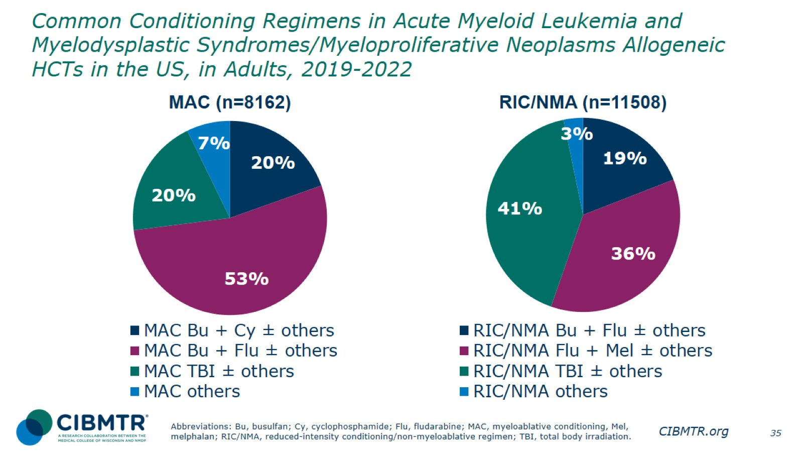
Common Conditioning Regimens in Acute Myeloid Leukemia and Myelodysplastic Syndromes/Myeloproliferative Neoplasms Allogeneic HCTs in the US, in Adults, 2019-2022
Notes:
Slide 35: This slide shows a breakdown of commonly used conditioning regimens for myeloablative (MAC) and reduced-intensity/non-myeloablative (RIC/NMA) conditioning in adult patients with AML or MDS/MPN.
Myeloablative conditioning regimen: regimens with total body irradiation doses of ≥500 cGY, single fractionated doses of ≥ 800 cGY, busulfan doses of > 9mg/kg oral or Bu ≥ 7.2 mg/kg IV, or melphalan doses of >150 mg/m² given as single agents or in combination with other drugs.
Reduced-intensity conditioning/non-myeloablative regimen: regimens with lower doses of total body irradiation, fractionated radiation therapy, busulfan, and melphalan than those used to define a myeloablative conditioning regimen (above).
References for conditioning intensity:
Bacigalupo A, Ballen K, Rizzo D, Giralt S, Lazarus H, Ho V, et al. Defining the intensity of conditioning regimens: working definitions. Biology of Blood and Marrow Transplantation: Journal of the American Society for Blood and Marrow Transplantation. 2009;15(12):1628–1633. doi: 10.1016/j.bbmt.2009.07.004.
Giralt S, Ballen K, Rizzo D, Bacigalupo A, Horowitz M, Pasquini M, et al. Reduced-intensity conditioning regimen workshop: defining the dose spectrum. Report of a workshop convened by the Center for International Blood and Marrow Transplant Research. Biology of Blood And Marrow Transplantation: Journal of the American Society for Blood and Marrow Transplantation. 2009;15(3):367–369. doi: 10.1016/j.bbmt.2008.12.497.

Slide 36
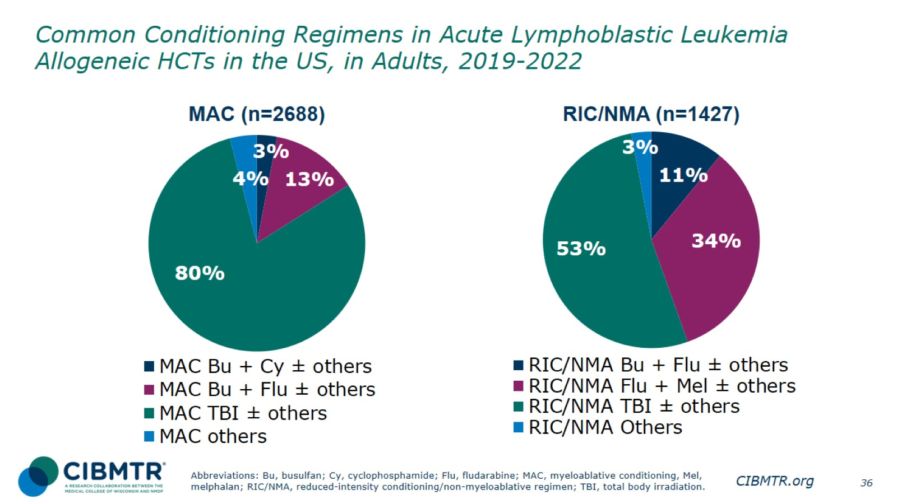
Common Conditioning Regimens in Acute Lymphoblastic Leukemia Allogeneic HCTs in the US, in Adults, 2019-2022
Notes:
Slide 36: This slide shows a breakdown of commonly used conditioning regimens for myeloablative (MAC) and reduced-intensity/non-myeloablative (RIC/NMA) conditioning in adult patients with ALL.

Slide 37
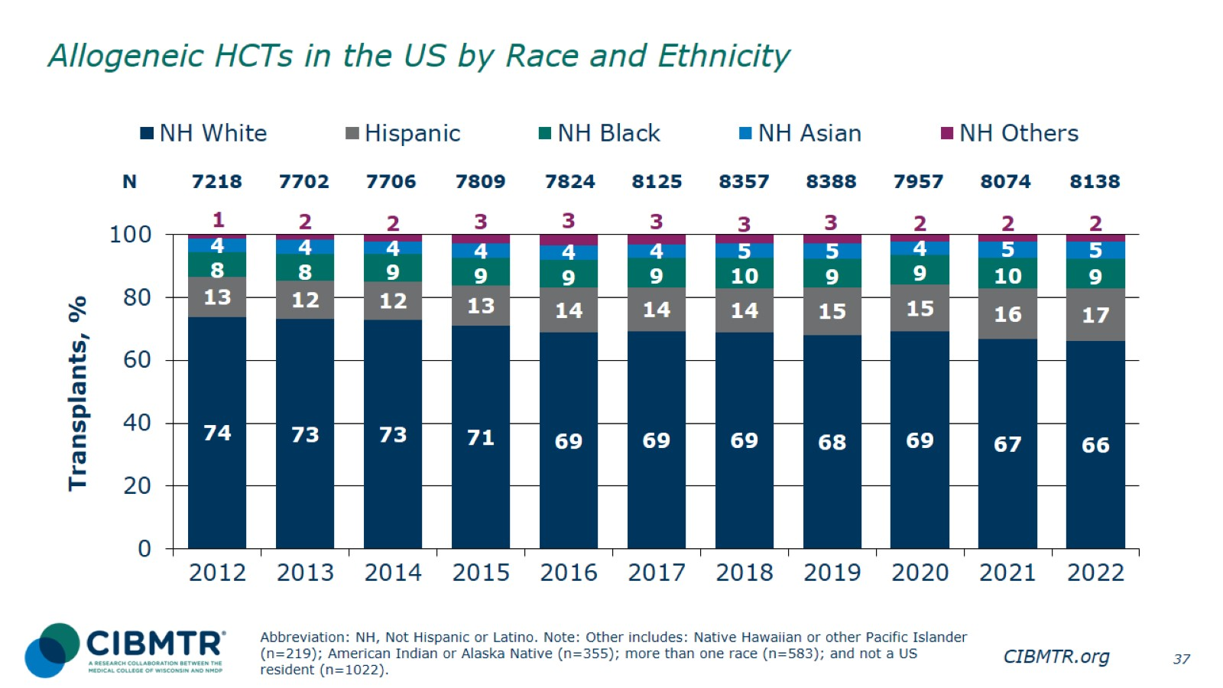
Allogeneic HCTs in the US by Race and Ethnicity
Notes:
Slide 37: Percentage of recipient center-reported race and ethnicity for allogeneic HCT recipients, 2012-2022.

Slide 38
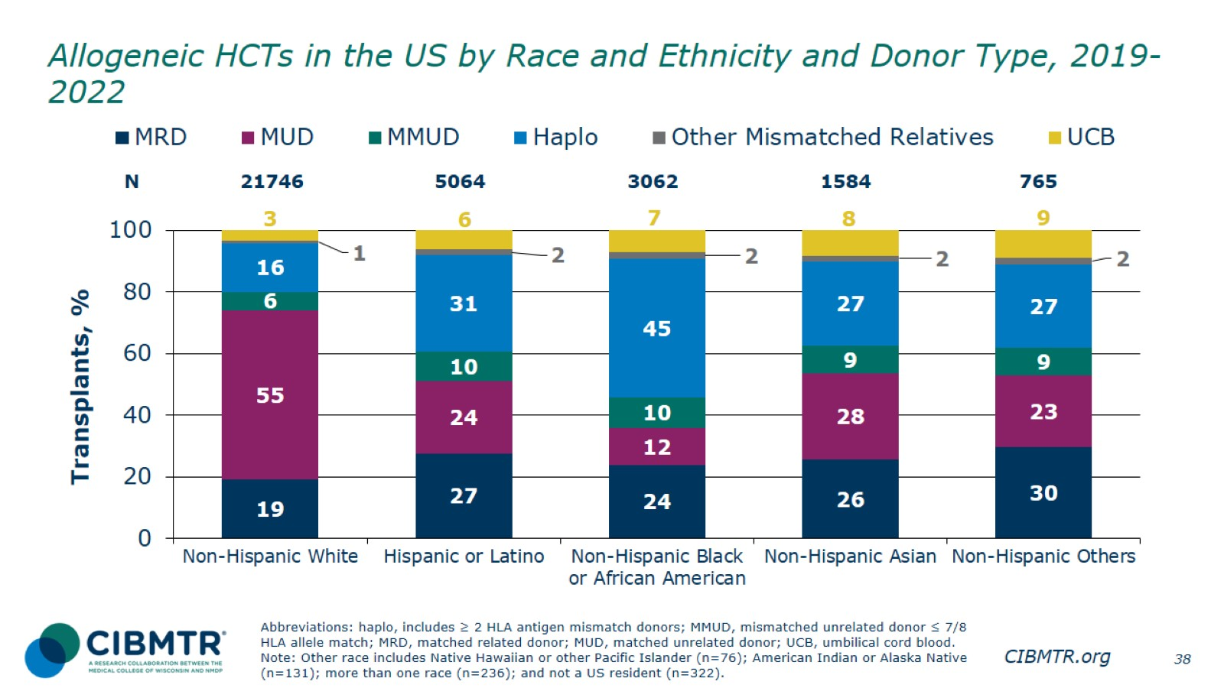
Allogeneic HCTs in the US by Race and Ethnicity and Donor Type, 2019-2022
Notes:
Slide 38: Percentage of donor type for allogeneic HCT recipients by race and ethnicity.

Slide 39
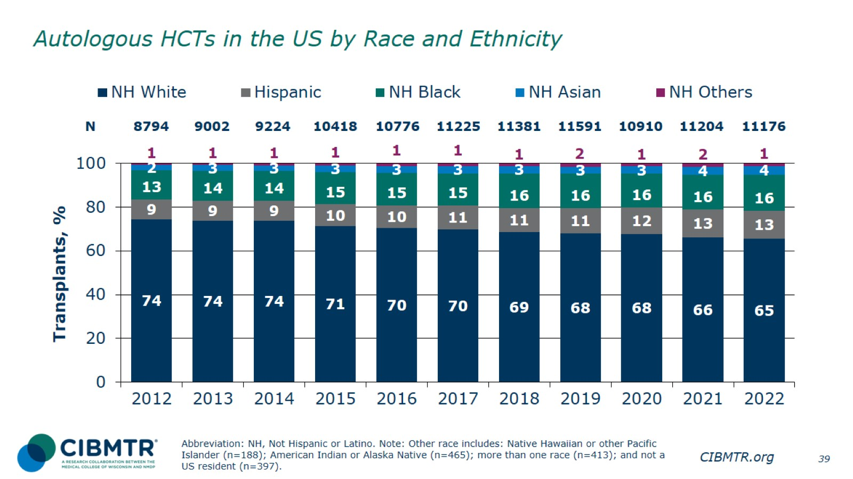
Autologous HCTs in the US by Race and Ethnicity
Notes:
Slide 39: Percentage of center reported recipient by race and ethnicity for autologous HCT recipients, 2012-2022.

Slide 40
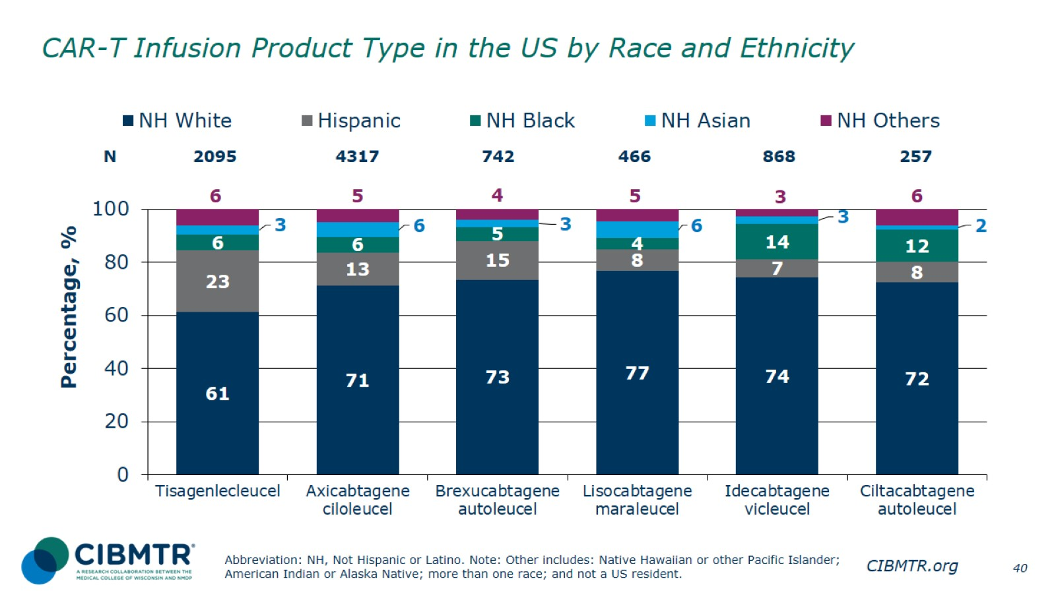
CAR-T Infusion Product Type in the US by Race and Ethnicity
Notes:
Slide 40: The percentage of patient center-reported by race and ethnicity for commercial CAR-T cell product types.

Slide 41
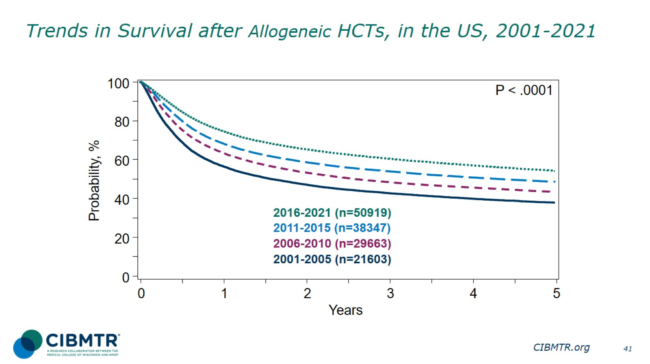
Trends in Survival after Allogeneic HCTs, in the US, 2001-2021
Notes:
Slide 41: Among the 140,532 patients receiving allogeneic HCT in US during 2001-2021, the 3-year probabilities (95% CI) of survival after allogeneic HCT during 2001-2021 in US are:
2016-2021 61.1% (60.6-61.5%)
2011-2015 54.7% (54.2-55.2%)
2006-2010 49.0% (48.5-49.6%)
2001-2005 43.4% (42.7-44.1%)
Trend data only are presented, and any significant P values reflect global differences between indicated groups and not any specific differences between indicated groups. Caution interpreting these univariate curves is important, as adjustment for other relevant factors using multivariable analyses has not been done.

Slide 42
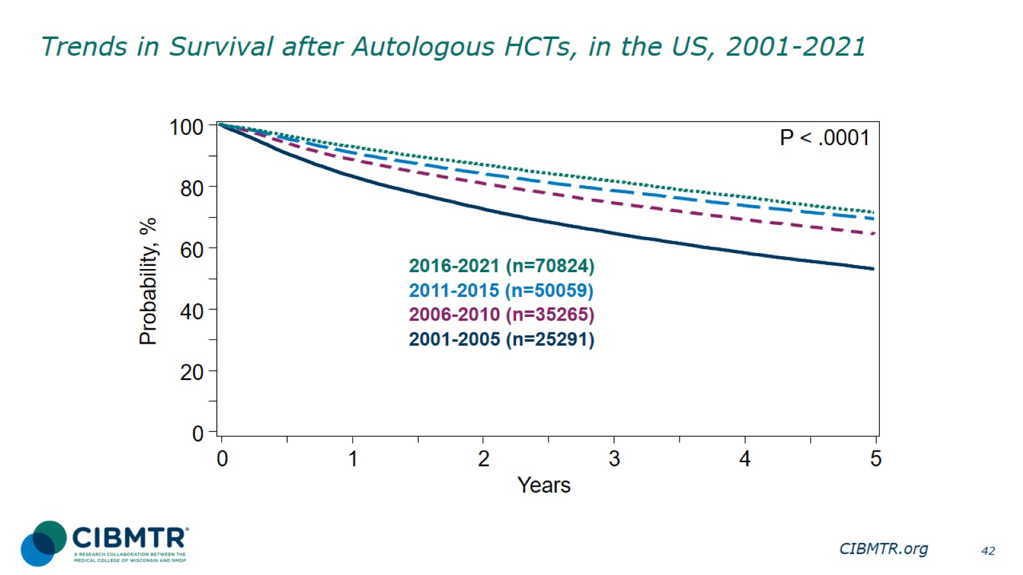
Trends in Survival after Autologous HCTs, in the US, 2001-2021
Notes:
Slide 42: Among the 181,439 patients receiving autologous HCT in US during 2001-2021, the 3-year probabilities (95% CI) of survival after autologous HCT during 2001-2021 in US are:
2016-2021 82.0% (81.6-82.3%)
2011-2015 78.8% (78.4-79.1%)
2006-2010 74.9% (74.4-75.4%)
2001-2005 65.2% (64.6-65.8%)

Slide 43
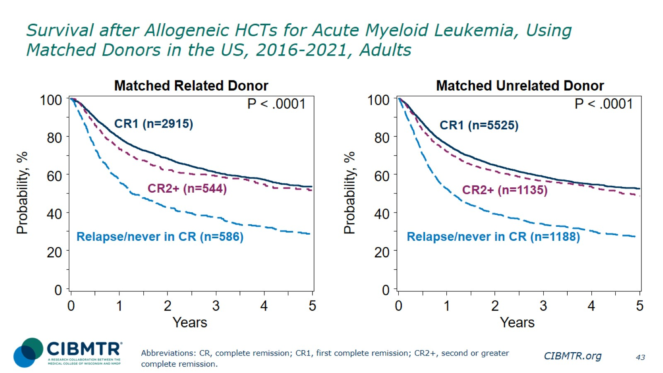
Survival after Allogeneic HCTs for Acute Myeloid Leukemia, Using Matched Donors in the US, 2016-2021, Adults
Notes:
Slide 43: Among 4,045 adult patients with AML receiving matched related donor transplant during 2016-2021, the 3-year probabilities (95% CI) of survival following transplant according to disease status are:
CR1
61.7% (59.8-63.6%)
CR2+ (2nd or greater complete remission)
59.9% (55.7-64.3%)
Relapsed disease/never in CR (includes primary induction failure)
38.3% (34.4-42.6%)
Among 7,848 adult patients with AML receiving matched unrelated donor transplant during 2016-2021, the 3-year probabilities (95% CI) of survival following transplant according to disease status are:
CR1
59.6% (58.3-61.1%)
CR2+ (2nd or greater complete remission)
57.1% (54.2-60.3%)
Relapsed disease/never in CR (includes primary induction failure)
35.0% (32.3-38.0%)
Trend data only are presented, and any significant P values reflect global differences between indicated groups and not any specific differences between indicated groups. Caution interpreting these univariate curves is important, as adjustment for other relevant factors using multivariable analyses has not been done.

Slide 44
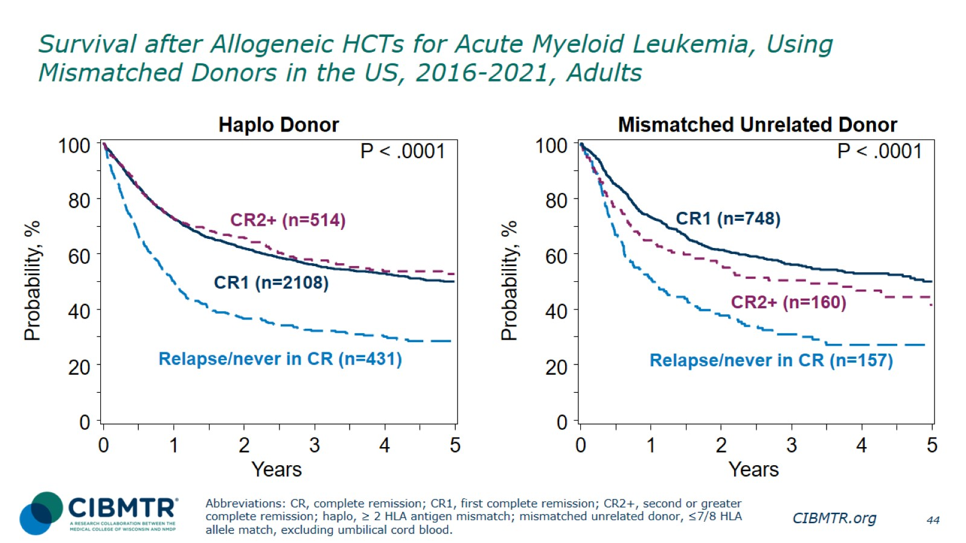
Survival after Allogeneic HCTs for Acute Myeloid Leukemia, Using Mismatched Donors in the US, 2016-2021, Adults
Notes:
Slide 44: Among 3,053 adult patients with AML receiving haplo donor transplant during 2016-2021, the 3-year probabilities (95% CI) of survival following transplant according to disease status are:
CR1
56.8% (54.6-59.2%)
CR2+ (2nd or subsequent complete remission)
58.5% (54.0-63.4%)
Relapse/never in CR (includes primary induction failure)
33.4% (29.0-38.3%)
Among 1,065 adult patients with AML receiving mismatched unrelated donor transplant during 2016-2021, the 3-year probabilities (95% CI) of survival following transplant according to disease status are:
CR1
56.7% (53.0-60.8%)
CR2+ (2nd or subsequent complete remission)
51.3% (43.6-60.2%)
Relapsed/never in CR (includes primary induction failure)
32.0% (25.4-40.5%)
Trend data only are presented, and any significant P values reflect global differences between indicated groups and not any specific differences between indicated groups. Caution interpreting these univariate curves is important, as adjustment for other relevant factors using multivariable analyses has not been done.

Slide 45
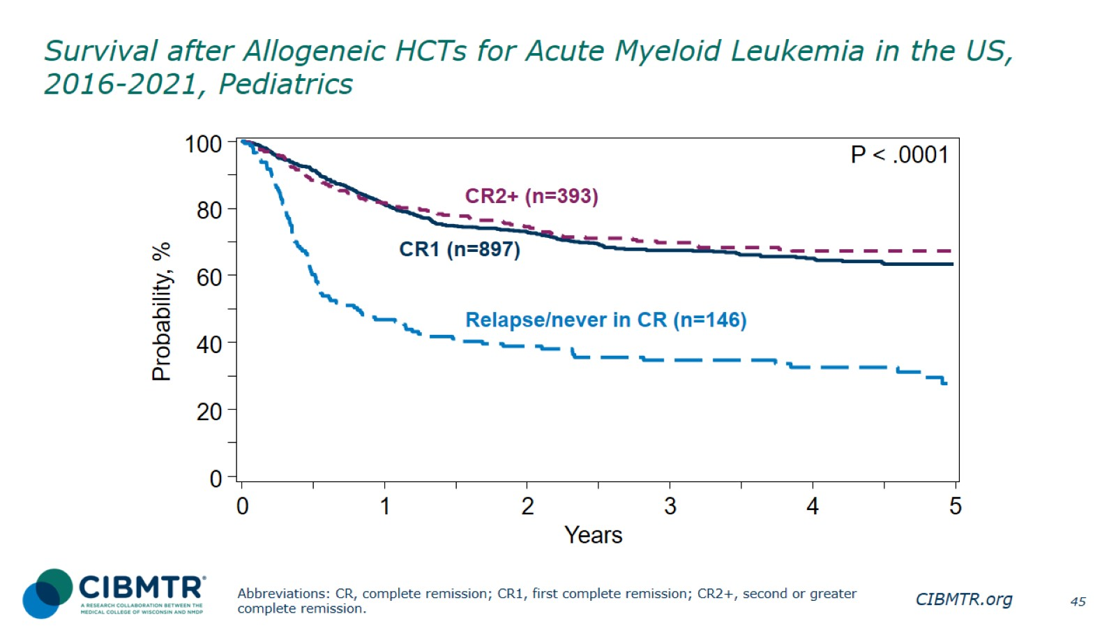
Survival after Allogeneic HCTs for Acute Myeloid Leukemia in the US, 2016-2021, Pediatrics
Notes:
Slide 45: Among 1,436 pediatric patients with AML receiving allogeneic transplant during 2016-2021, the 3-year probabilities (95% CI) of survival following transplant according to disease status are:
CR1
68.0% (64.8-71.3%)
CR2+ (2nd or subsequent complete remission)
70.1% (65.3-75.1%)
Relapse/never in CR (includes primary induction failure)
35.6% (28.4-44.5%)
Trend data only are presented, and any significant P values reflect global differences between indicated groups and not any specific differences between indicated groups. Caution interpreting these univariate curves is important, as adjustment for other relevant factors using multivariable analyses has not been done.

Slide 46
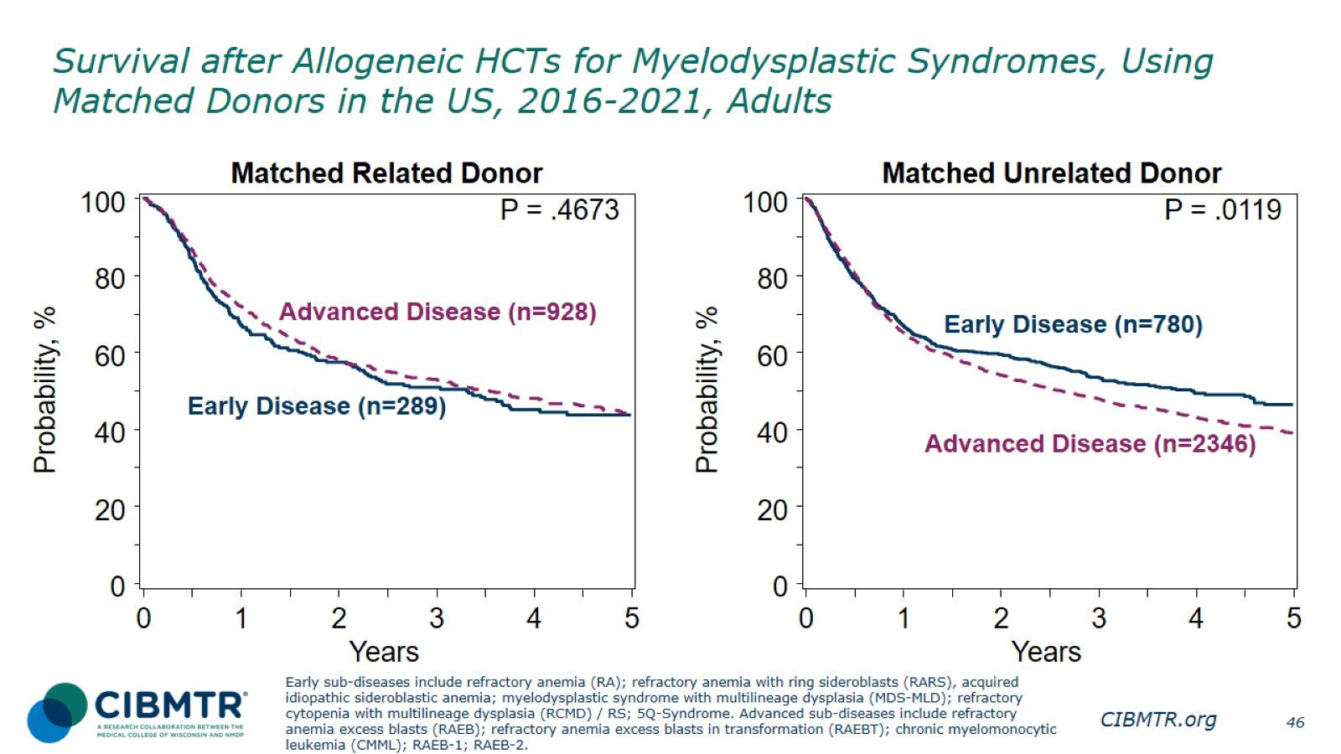
Survival after Allogeneic HCTs for Myelodysplastic Syndromes, Using Matched Donors in the US, 2016-2021, Adults
Notes:
Slide 46: Among 1,217 patients with a matched related donor allotransplants performed during 2016-2021 in recipients with early and advanced disease MDS, the 3-year probabilities (95% CI) of survival following transplant according to disease status are:
Early disease 51.5% (45.8-57.8%)
Advanced disease 53.7% (50.4-57.2%)
The 3-year probabilities (95% CI) of survival following transplant among 3,126 patients with a matched unrelated donor according to disease status are:
Early disease 54.1% (50.5-57.9%)
Advanced disease 48.7% (46.6-51.0%)
Reference for MDS classifications:
https://higherlogicdownload.s3.amazonaws.com/ASBMT/43a1f41f-55cb-4c97-9e78-c03e867db505/UploadedImages/ASBMT_RFI_2018B_CIBMTR_Disease_Classifications.pdf
Trend data only are presented, and any significant P values reflect global differences between indicated groups and not any specific differences between indicated groups. Caution interpreting these univariate curves is important, as adjustment for other relevant factors using multivariable analyses has not been done.

Slide 47
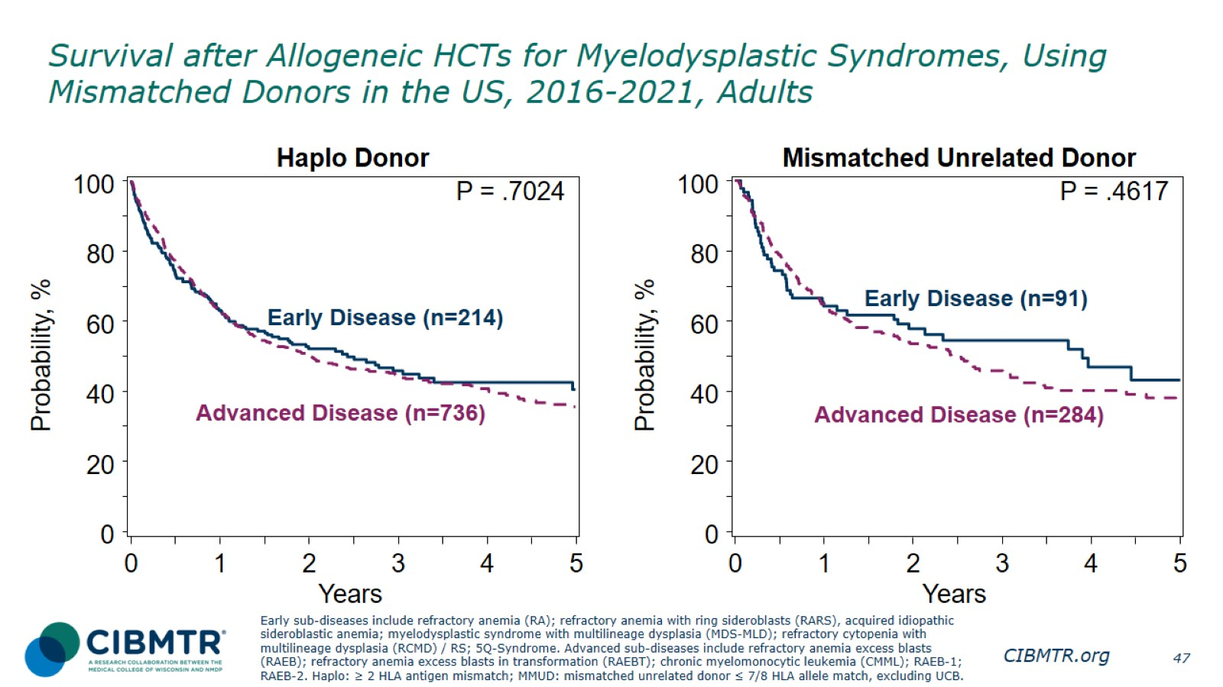
Survival after Allogeneic HCTs for Myelodysplastic Syndromes, Using Mismatched Donors in the US, 2016-2021, Adults
Notes:
Slide 47: Among 950 adult patients with a haplo donor receiving allogeneic transplant for early and advanced MDS performed during 2016-2021, the 3-year probabilities (95% CI) of survival following transplant according to disease status are:
Early disease 46.7% (39.9-54.6%)
Advanced disease 45.3% (41.5-49.3%)
Among 375 adult patients with a mismatched unrelated donor, the 3-year probabilities (95% CI) of survival following transplant according to disease status are:
Early disease 55.2% (45.4-67.0%)
Advanced disease 46.6% (40.7-53.3%)
Trend data only are presented, and any significant P values reflect global differences between indicated groups and not any specific differences between indicated groups. Caution interpreting these univariate curves is important, as adjustment for other relevant factors using multivariable analyses has not been done.

Slide 48
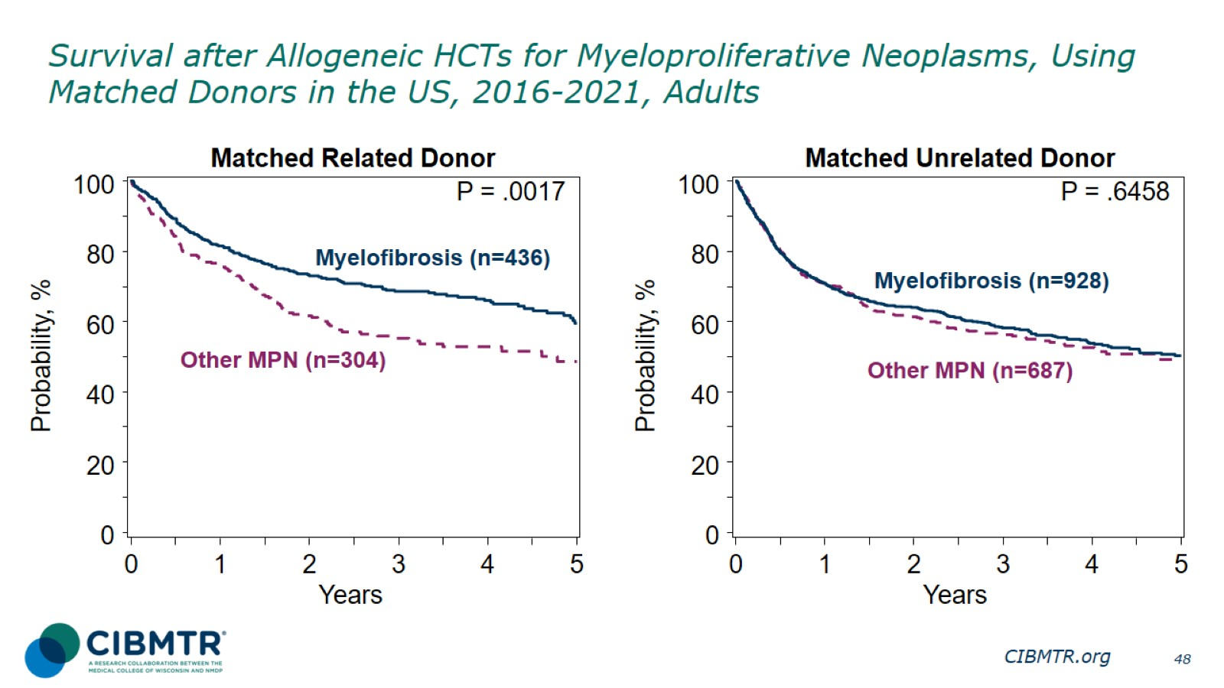
Survival after Allogeneic HCTs for Myeloproliferative Neoplasms, Using Matched Donors in the US, 2016-2021, Adults
Notes:
Slide 48:
Among 740 adult patients with a matched related donor, the 3-year probabilities (95% CI) of survival following transplant according to disease status are:
Myelofibrosis 69.1% (64.7-73.8%)
Other MPN 55.9% (49.9-62.5%)
Among 1,615 adult patients with a matched unrelated donor, the 3-year probabilities (95% CI) of survival following transplant according to disease status are:
Myelofibrosis 58.9% (55.7-62.4%)
Other MPN 57.0% (53.0-61.4%)
Trend data only are presented, and any significant P values reflect global differences between indicated groups and not any specific differences between indicated groups. Caution interpreting these univariate curves is important, as adjustment for other relevant factors using multivariable analyses has not been done.

Slide 49
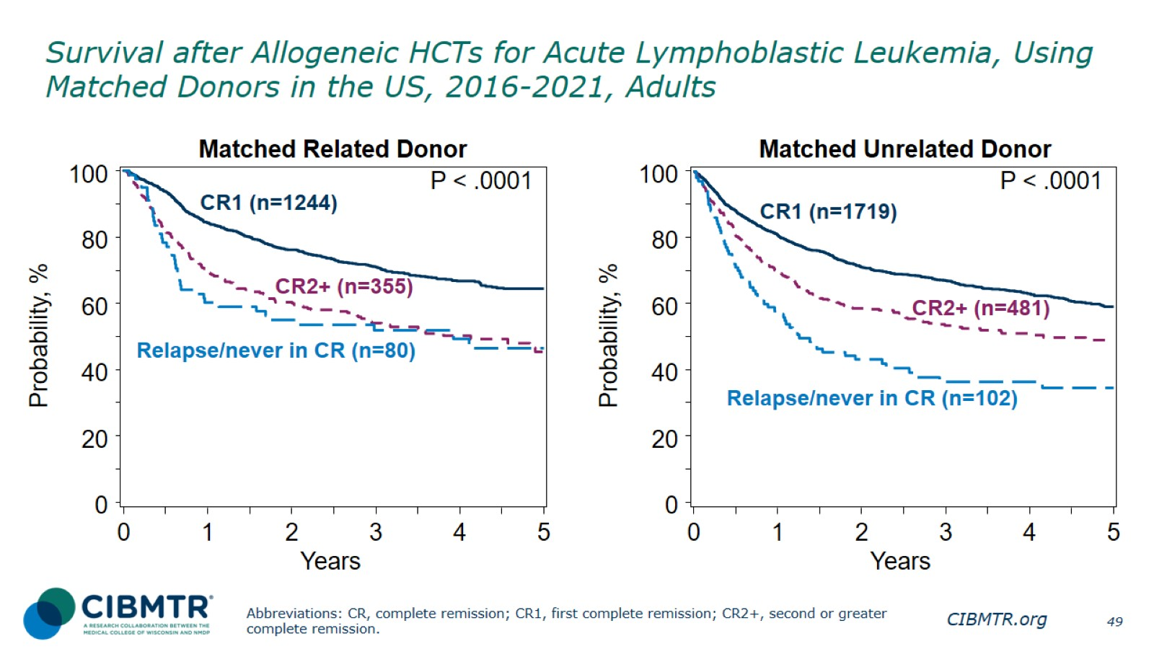
Survival after Allogeneic HCTs for Acute Lymphoblastic Leukemia, Using Matched Donors in the US, 2016-2021, Adults
Notes:
Slide 49: Among 1,679 adult patients with a matched related donor, the 3-year probabilities (95% CI) of survival following transplant according to disease status are:
CR1
71.4% (68.8-74.2%)
CR2+ (2nd or subsequent complete remission)
54.7% (49.4-60.6%)
Relapse/never in CR (includes primary induction failure)
52.7% (42.6-65.1%)
Among the 2,302 adult recipients of matched unrelated donor HCT. The 3-year probabilities (95% CI) of survival following transplant according to disease status are:
CR1
67.4% (65.1-69.8%)
CR2+ (2nd or subsequent complete remission)
54.1% (49.5-59.1%)
Relapse/never in CR (includes primary induction failure)
37.4% (28.7-48.7%)
Trend data only are presented, and any significant P values reflect global differences between indicated groups and not any specific differences between indicated groups. Caution interpreting these univariate curves is important, as adjustment for other relevant factors using multivariable analyses has not been done.

Slide 50
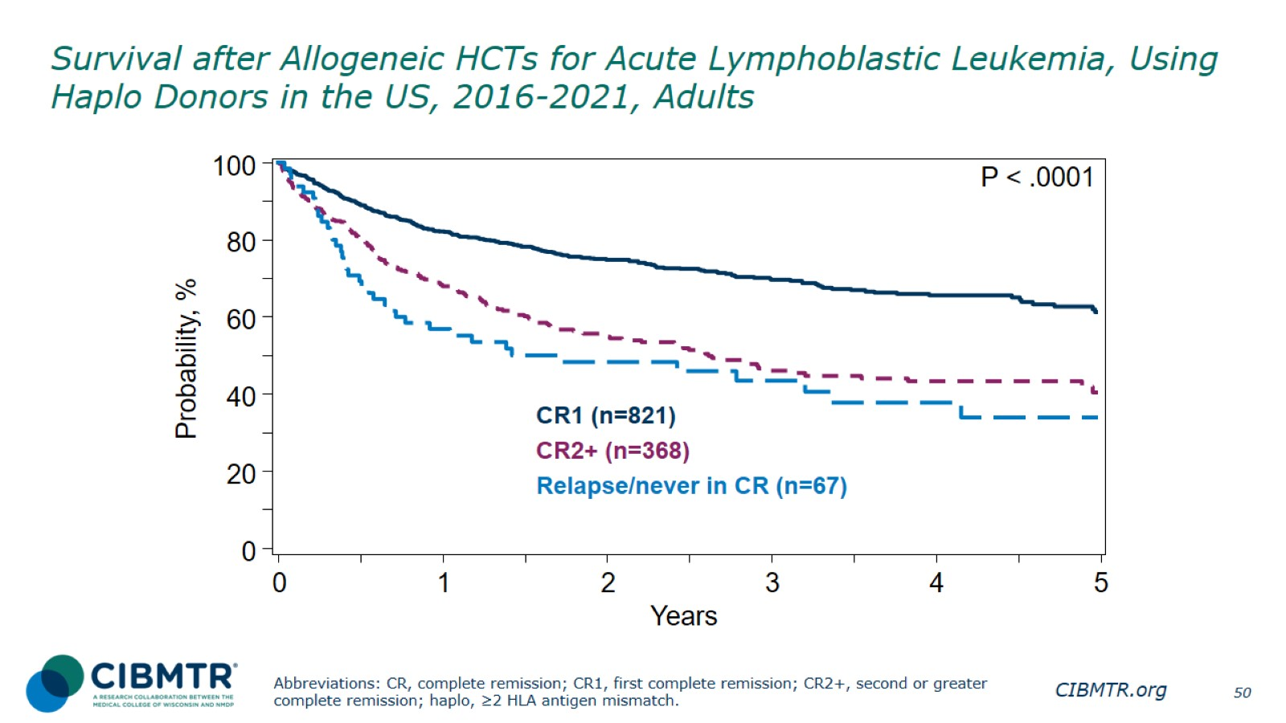
Survival after Allogeneic HCTs for Acute Lymphoblastic Leukemia, Using Haplo Donors in the US, 2016-2021, Adults
Notes:
Slide 50: Among 1,256 adult patients receiving a haplo donor transplant for ALL during 2016-2021, the 3-year probabilities (95% CI) of survival following transplant according to disease status are:
CR1
70.6% (67.2-74.0%)
CR2+ (2nd or subsequent complete remission)
46.9% (41.3-53.1%)
Relapse/never in CR (includes primary induction failure)
44.3% (33.2-59.1%)
Trend data only are presented, and any significant P values reflect global differences between indicated groups and not any specific differences between indicated groups. Caution interpreting these univariate curves is important, as adjustment for other relevant factors using multivariable analyses has not been done.

Slide 51

Survival after Allogeneic HCTs for Acute Lymphoblastic Leukemia in the US, 2016-2021, Pediatrics
Notes:
Slide 51: Among 1,721 pediatric patients receiving allogeneic transplant for ALL during 2016-2021, the 3-year probabilities (95% CI) of survival following transplant according to disease status are:
CR1
80.0% (76.7-83.4%)
CR2+ (2nd or subsequent complete remission)
71.5% (68.7-74.4%)
Relapse/never in CR (includes primary induction failure)
62.6% (50.6-77.5%)
Trend data only are presented, and any significant P values reflect global differences between indicated groups and not any specific differences between indicated groups. Caution interpreting these univariate curves is important, as adjustment for other relevant factors using multivariable analyses has not been done.

Slide 52

Survival after Allogeneic HCTs for Severe Aplastic Anemia, in the US, 2016-2021
Notes:
Slide 52: Allogeneic HCT is the treatment of choice for young patients with severe aplastic anemia (SAA) who have an HLA-matched sibling donor.
Among 734 pediatric patients who underwent transplantation for SAA during 2016-2021, the 3-year probabilities (95% CI) of survival following transplant according by donor type are:
Matched related donors 98.6% (97.3-100.0%)
Matched unrelated donors 92.5% (89.3-95.9%)
Mismatched unrelated donors 89.2% (81.7-97.4%)
Haplo donors 88.9% (82.9-95.4%)
Among 1,064 adult patients who underwent transplantation for SAA during 2016-2021, the 3-year probabilities (95% CI) of survival following transplant according by donor type are:
Matched related donors 88.8% (85.4-92.3%)
Haplo donors 85.9% (81.0-91.2%)
Matched unrelated donors 78.3% (74.4-82.4%)
Mismatched unrelated donors 74.8% (64.2-87.2%)
Trend data only are presented, and any significant P values reflect global differences between indicated groups and not any specific differences between indicated groups. Caution interpreting these univariate curves is important, as adjustment for other relevant factors using multivariable analyses has not been done.

Slide 53

Survival after Allogeneic HCTs for Sickle Cell Disease in the US, 2016-2021, Pediatrics
Notes:
Slide 53: Among 638 pediatric patients receiving allogeneic transplant for SCD during 2016-2021, the 3-year probabilities (95% CI) of survival following transplant is:
Overall 95.4% (93.7-97.2%)
Trend data only are presented, and any significant P values reflect global differences between indicated groups and not any specific differences between indicated groups. Caution interpreting these univariate curves is important, as adjustment for other relevant factors using multivariable analyses has not been done.

Slide 54

Survival after HCTs for Primary Immune Deficiency in the US, 2016-2021, Pediatrics
Notes:
Slide 54: Among 987 pediatric patients receiving allogeneic transplant for PID during 2016-2021, the 3-year probabilities (95% CI) of survival following transplant is:
Overall 81.4% (79.0-84.0%)
Trend data only are presented, and any significant P values reflect global differences between indicated groups and not any specific differences between indicated groups. Caution interpreting these univariate curves is important, as adjustment for other relevant factors using multivariable analyses has not been done.

Slide 55

Survival after Autologous or Allogeneic HCTs for Hodgkin Lymphoma, in the US, 2016-2021
Notes:
Slide 55: Among the 4,921 patients receiving autologous HCT for Hodgkin lymphoma (HL) during 2016-2021, the 3-year probabilities (95% CI) of survival following transplant according to disease status are:
Chemosensitive disease 92.6% (91.7-93.5%)
Chemoresistant disease 88.7% (84.5-93.1%)
Among the 699 patients receiving allogeneic HCT for HL during 2016-2021, the 3-year probabilities (95% CI) of survival following transplant according to disease status are:
Chemosensitive disease 74.2% (70.5-78.1%)
Chemoresistant disease 58.2% (49.3-68.9%)
Trend data only are presented, and any significant P values reflect global differences between indicated groups and not any specific differences between indicated groups. Caution interpreting these univariate curves is important, as adjustment for other relevant factors using multivariable analyses has not been done.

Slide 56

Survival after Autologous or Allogeneic HCTs for Follicular Lymphoma, in the US, 2016-2021
Notes:
Slide 56: Among the 894 patients receiving autologous HCT for FL during 2016-2021, the 3-year probabilities (95% CI) of survival following transplant according to disease status are:
Chemosensitive disease 85.2% (82.6-88.0%)
Chemoresistant disease 59.5% (43.5-81.6%)
Among the 306 patients receiving allogeneic HCT for FL during 2016-2021, the 3-year probabilities (95% CI) of survival following transplant according to disease status are:
Chemosensitive disease 78.3% (73.3-83.7%)
Chemoresistant disease 73.3% (62.2-86.4%)
Trend data only are presented, and any significant P values reflect global differences between indicated groups and not any specific differences between indicated groups. Caution interpreting these univariate curves is important, as adjustment for other relevant factors using multivariable analyses has not been done.

Slide 57

Survival after First Autologous HCTs for Multiple Myeloma and Amyloidosis, in the US, 2016-2021
Notes:
Slide 57: Among the 43,515 patients receiving first autologous HCT for multiple myeloma and amyloidosis during 2016-2021, the 3-year probabilities (95% CI) of survival after their autologous HCT are:
Amyloidosis 89.4% (87.7-91.1%)
Multiple Myeloma 84.6% (84.2-85.0%)
Trend data only are presented, and any significant P values reflect global differences between indicated groups and not any specific differences between indicated groups. Caution interpreting these univariate curves is important, as adjustment for other relevant factors using multivariable analyses has not been done.

Slide 58

Survival after First CAR-T Infusion for DLBCL, in the US, 2016-2021
Notes:
Slide 58: Among 4196 patients receiving CAR-T infusion for DLBCL during 2016-2021 in US, the 3-year probabilities (95% CI) of survival are:
Overall 42.9% (41.2-44.7%)
Trend data only are presented, and any significant P values reflect global differences between indicated groups and not any specific differences between indicated groups. Caution interpreting these univariate curves is important, as adjustment for other relevant factors using multivariable analyses has not been done.

Slide 59

Survival after First CAR-T Infusion for Acute Lymphoblastic Leukemia, in the US, 2016-2021
Notes:
Slide 59: The 3-year probabilities (95% CI) of survival for 1018 patients who received first CAR-T infusion during 2016-2021 in US for ALL, by age groups are:
Pediatrics 67.9% (64.1-72.0%)
Adults 50.4% (44.5-57.1%)
Trend data only are presented, and any significant P values reflect global differences between indicated groups and not any specific differences between indicated groups. Caution interpreting these univariate curves is important, as adjustment for other relevant factors using multivariable analyses has not been done.

